Slide 1
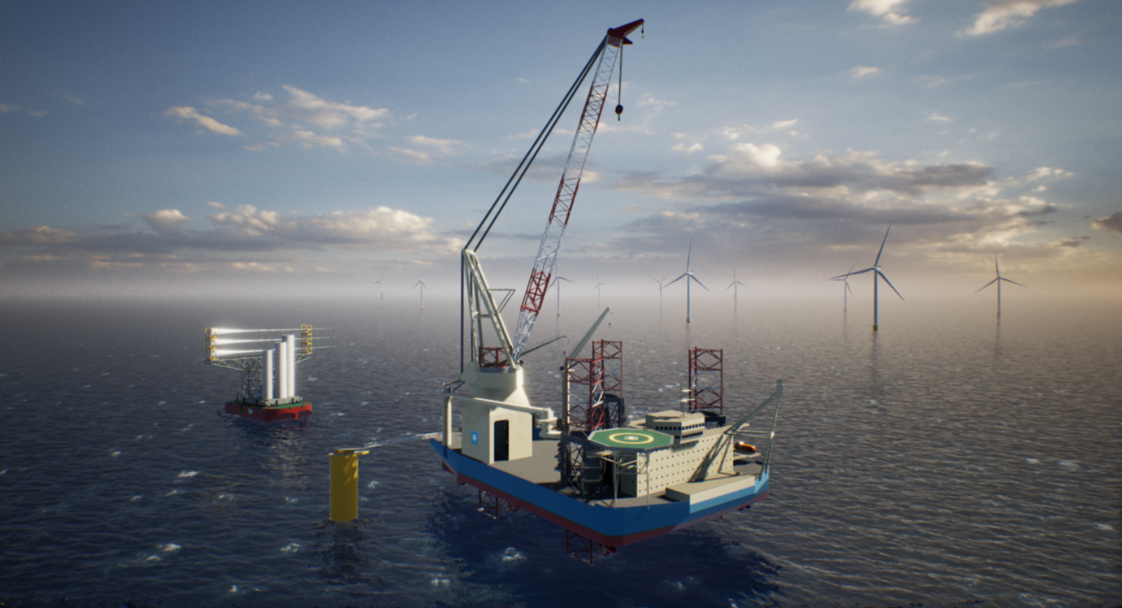
OFFSHORE INSTALLATION CONTRACTS
FOR FIXED BOTTOM WIND FARMS
Jacob C. Jørgensen
Amsterdam, 29 November 2022

Slide 2
Maersk Supply Services
Maersk Supply Service A/S
Part of A.P. Møller Mærsk A/S company group
Established in 1967
Owns and operates 38 vessels
Operations worldwide in the offshore industry
Offshore wind focus (USA):
https://www.youtube.com/watch?v=dHipfehndRM

Slide 3
The traditional installation contract
The WTG installation contract
Traditionally based on time charter templates such as the BIMCO SupplyTime 2005 or 2017:
No duty to produce a result
Day rates rather than lump sum
Off hire / On hire rather than milestone payments for sections
No LDs or EOT
Seabed risk allocation to the Charterers
Only real risk allocated to the Owners = break-down of vessel (off hire)

Slide 4
The new form of installation contract
The ”new” types of WTG installation contracts are influenced by the way offshore wind projects are often financed (i.e., through non/limited recourse finance)
The installation contracts are generally becoming more ”EPC” and less ”charter party”
Lump sum and sectional completion rather than day rates
LDs and EOT clauses
Seabed risk partly allocated to the vessel owners (e.g. through liquidated damages linked to jacking time).
Interface agreement allocates the project coordination risk onto the vessel owners and other sub-contractors

Slide 5
Challenges
Challenges using EPC contract terms for offshore WTG installations:
Scope interface with OEM (transporting and lifting but no bolts or cables – when are the Works completed?)
Seabed conditions cannot be improved like in onshore projects (delays generally cannot be ”caught up”)
Importantly: Substitution vessels cannot readily be found and prepped (jacking and crane capacity and sea-fastening issues)
Float has less value to the contractor since progress depends on the OEM making the WTGs available
Drop dead date: The vessel owners need to know when the vessel is released from the project.

Slide 6
Delays
Common sources of delay:
Weather: Typically adverse weather has been factored into the agreed time programme.
Seabed: Client provides data and the vessel owner interprets the data. The seabed risk is a key issue due to the client’s need to position the WTGs across the offshore site before the foundations are installed. Yet jacking trials are rarely performed.
Vessel Breakdowns: The Vessel Owner’s main concern and main delay risk. Risk migitation measures include:
High degree of control and safety surrounding crane operations and jacking
Access to strategic spares is paramount
Business interruption insurance as an additon to the H&M insurance (costly)
Contingencies

Slide 7
Delays
Liquidated Damages:
”Cascading LDs”?: It should be regulated whether a delay in completing a section will be give rise to LDs on only that section or whether the same delaying event can result in LDs on every delayed section until it is absorbed.
Concurrency should be regulated, e.g., by ”apportioning”.
Float will often occur in the form of ”better weather days”.
Float should be regulated, although in practical life the Client will usually insist on owning the float.

Slide 8
Delays
Extension of Time for Completion (EOT):
Payment of ”Extension Hire” should be regulated to ensure the vessel owner some cashflow when the client delays the project (and thus the payment-triggering milstones from being completed).
Adverse seabed conditions
Adverse weather
Variations:
WTG components (dimensions, weight, CoG)
Work method (lifting plans, use of cranes, number of transits)
WTG locations

Slide 9
Delays
Delay Analysis:
Typically, all vessel activities throughout the day will be logged in the daily reports, which are of key importance when evidencing the cause of delays.
Concurrent delays can arise in relation to adverse weather/adverse seabed conditions (Client risk) and technical breakdowns (Vessel Owner Risk).
Disputes arise both in relation to LDs and in relation to the long stop date

Slide 10
Delays
Particular Challenges:
Adverse seabed conditions: Burden and method of proof?
Contributory negligence in relation to crane operations: The role of the ”black box”
Knock for Knock event damaging the vessel and resulting in project delays and loss of revenue/LDs under the power purchase agreement?– How wide is the application of the knock for knock indemnity?

Slide 11
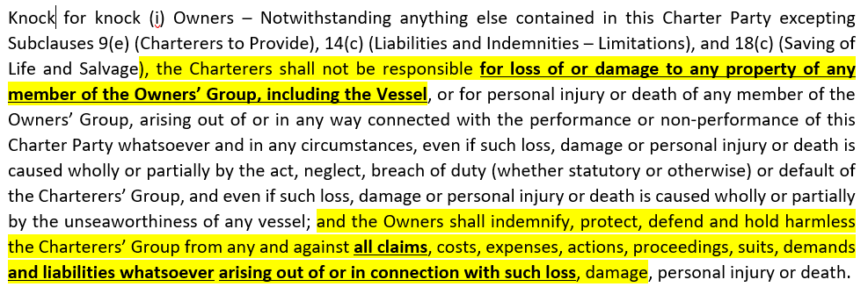
Delays
BIMCO Supplytime (2017) cl. 14.a:

Slide 12
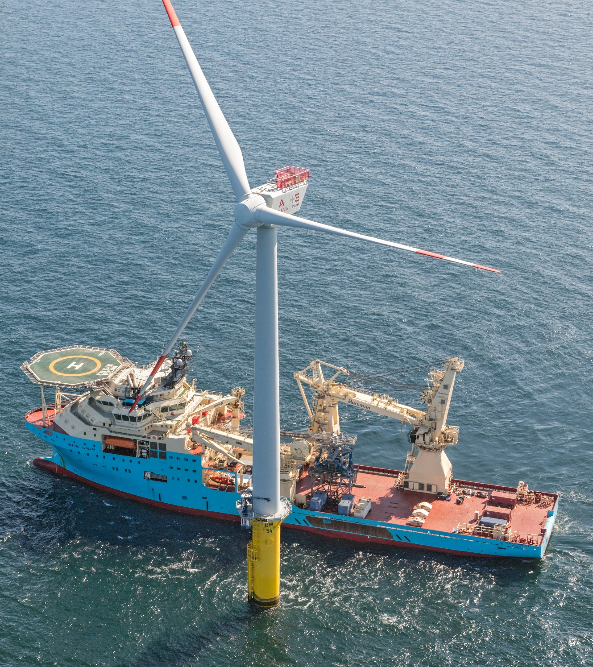
Q&A Session

