Slide 1
Integrating Sustainability in Construction Contracts

Slide 2
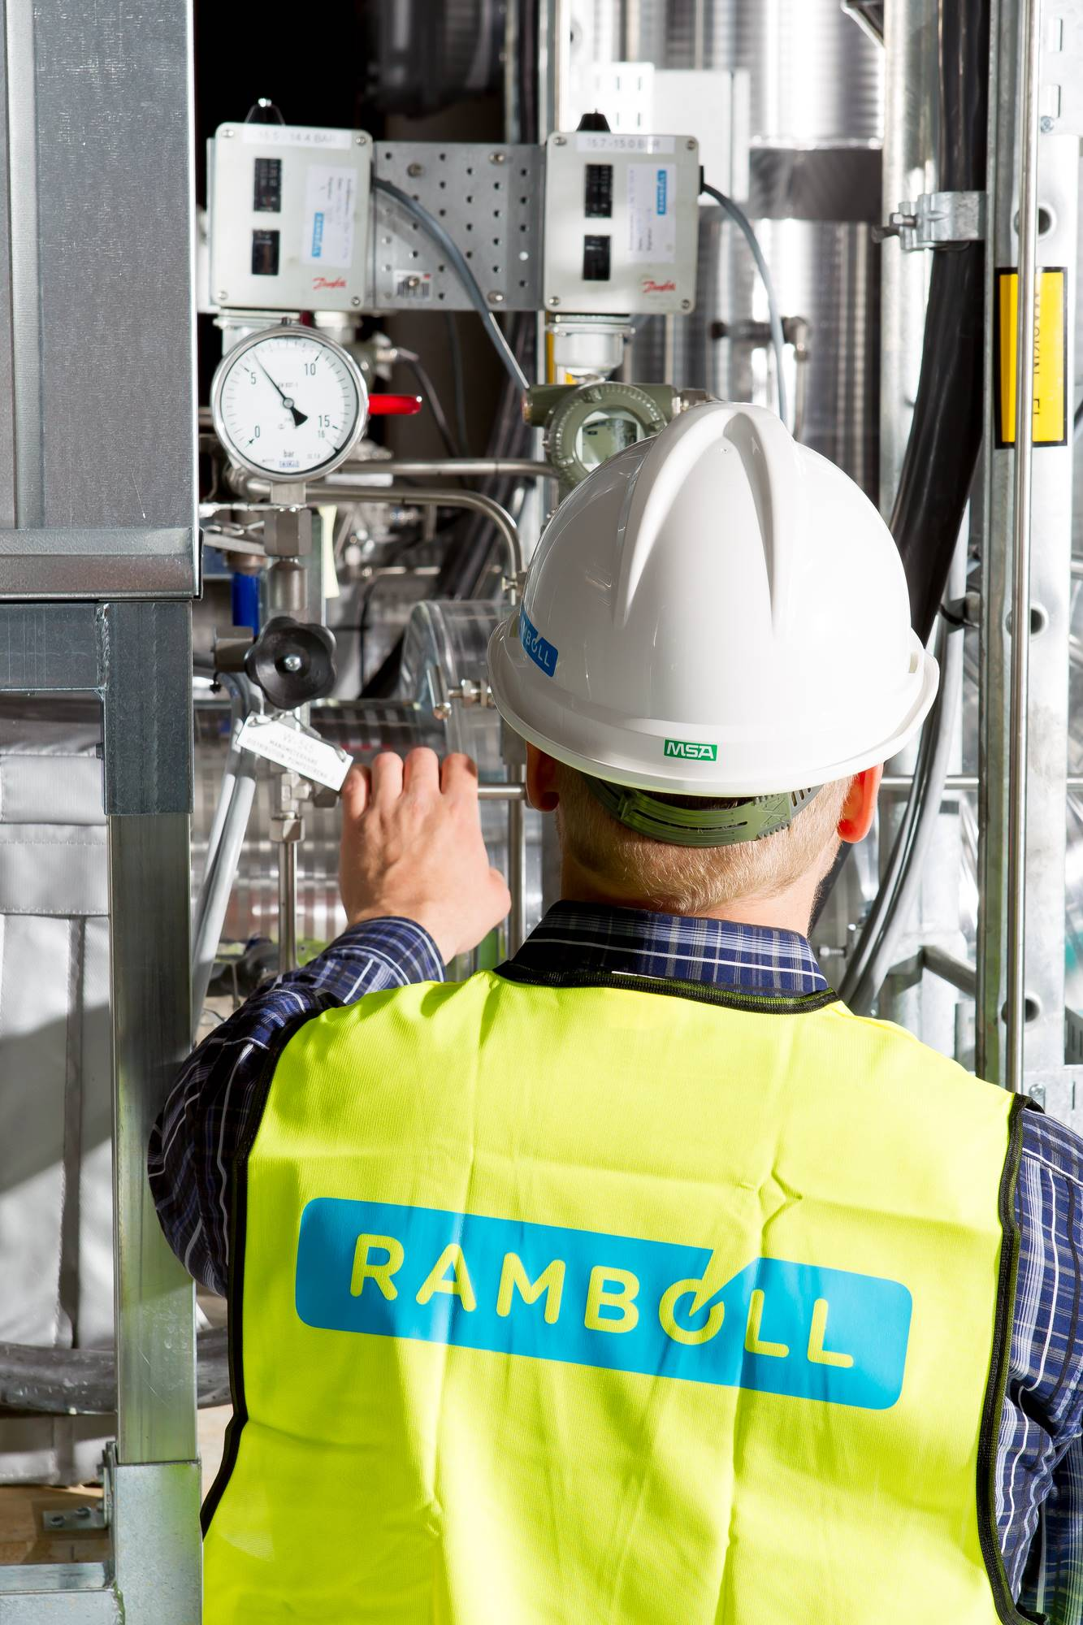
Agenda
01
Introduction – who we are
02
Sustainability in major projects – specific project examples
03
How Procurement can play a key role in integrating sustainability from an early phase of a project?
04
How Contract Management can support the realisation of a project's sustainability objectives?
05
How to put sustainability on the agenda in your project?

Slide 3
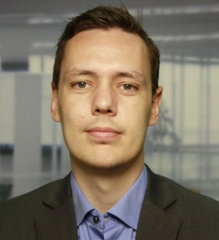
Who we are
dfdf
René Søegaard
Director
Legal & Contract Management Consulting
rsoe@ramboll.com
+45 5161 1445
Lars Boe Riber
Manager
Legal & Contract Management Consulting
lbri@ramboll.com
+45 5161 3570
Primary work areas
Project contract management on major construction projects
Contract and commercial advisory services
Strategic advisory
Key words
Experienced Contract Management leader
Wide experience within complex CAPEX-projects, onshore and offshore
Vast FIDIC suite knowledge
Procurement and supply chain experience
Primary work areas
Construction and infrastructure advisory services
Procurement and contract management
Legal services
Key words
Focus on business oriented and implementable solutions
Operational experience from both buy and sell side
International experience in large and small scale project
Working within contract management roles since 2012
Formal legal education

Slide 4
Ramboll in brief
Independent architecture, engineering and consultancy company
Founded 1945 in Denmark
17,000 experts
Present in 35 countries
Particularly strong presence in the Nordics, the UK, North America, Continental Europe, and Asia Pacific
Creating sustainable solutions across Buildings, Transport, Energy, Environment & Health, Water, Management Consulting and Architecture & Landscape.
EUR 1.9 billion revenue
Owned by Rambøll Fonden – The Ramboll Foundation

Slide 5
Geographical footprint
Ramboll Head Office
Ramboll offices
Notes:
A1

Slide 6
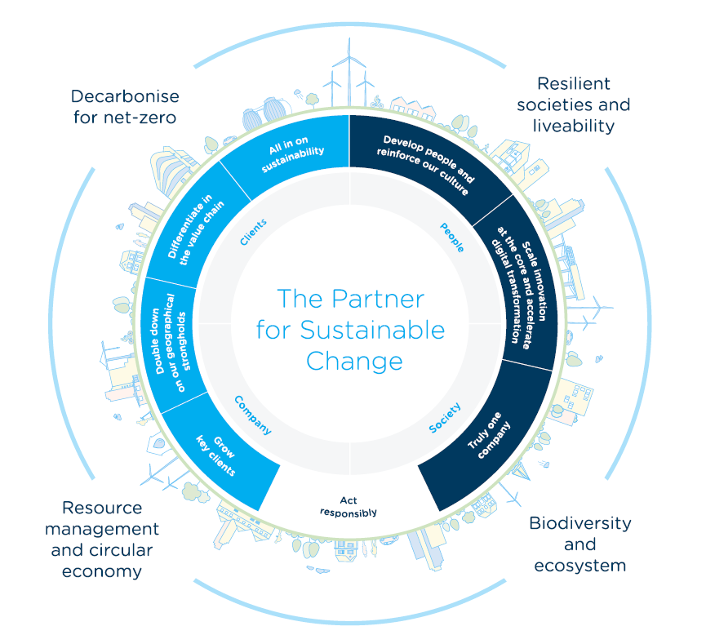
All in on Sustainability
Ramboll is the trusted partner for our clients, creating value by guiding them successfully through sustainable change, while understanding specific challenges and opportunities.
Our strategy for 2022-25 – Partner for Sustainable Change - supports this ambition and focuses on four sustainability themes where the needs of clients, stakeholders and society intersect with our expertise:
Decarbonise for net-zero
Resilient societies and liveability
Resource management and circular economy
Biodiversity and ecosystems

Slide 7
Sustainability in major projects - specific project examples

Slide 8
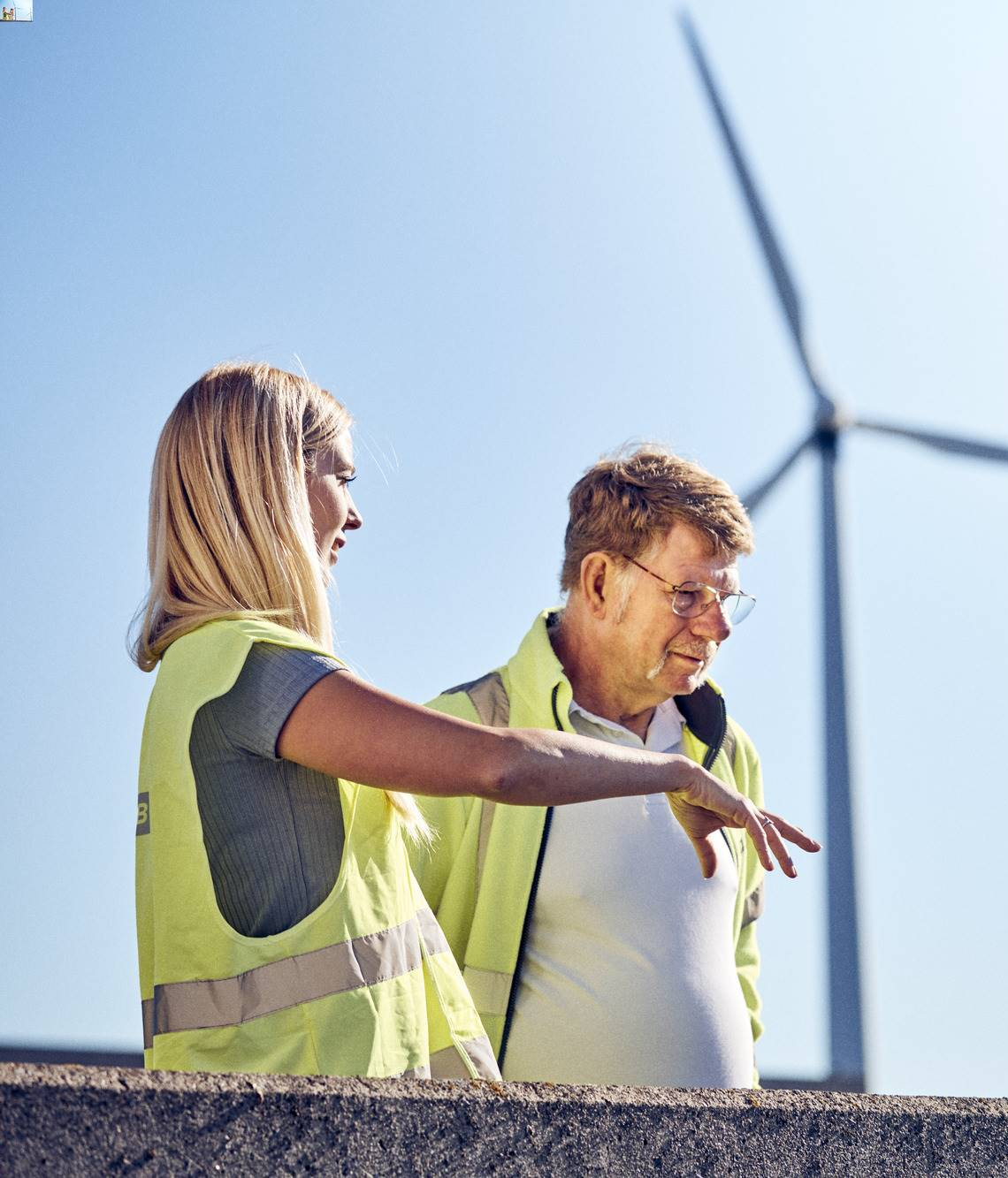
Green is not always green and green can often be greener
Sustainability │ Procurement │ Contract Management │ How to do it
The focus on sustainability continues to intensify, which is good, but it also raises question of what sustainability actually means and when we are sufficiently sustainable.
There is still a tendency for sustainability to be an afterthought. There is a need to consider more aspects of each project in a sustainability context in early stages:
Decommissioning is often not considered in a sustainability perspective – e.g., for windfarms there is a challenge with current blades not being recyclable.
Embodied carbon is not considered for the full supply chain of a project throughout its construction phase even though the majority of embodied emissions are releases before the projects are finished.
Secondary or tertiary uses - whatever is being built can potentially have secondary uses in a sustainability context alongside their main functions.
Source: https://ramboll.com/media/rgr/embodied-carbon-and-how-to-tackle-it

Slide 9
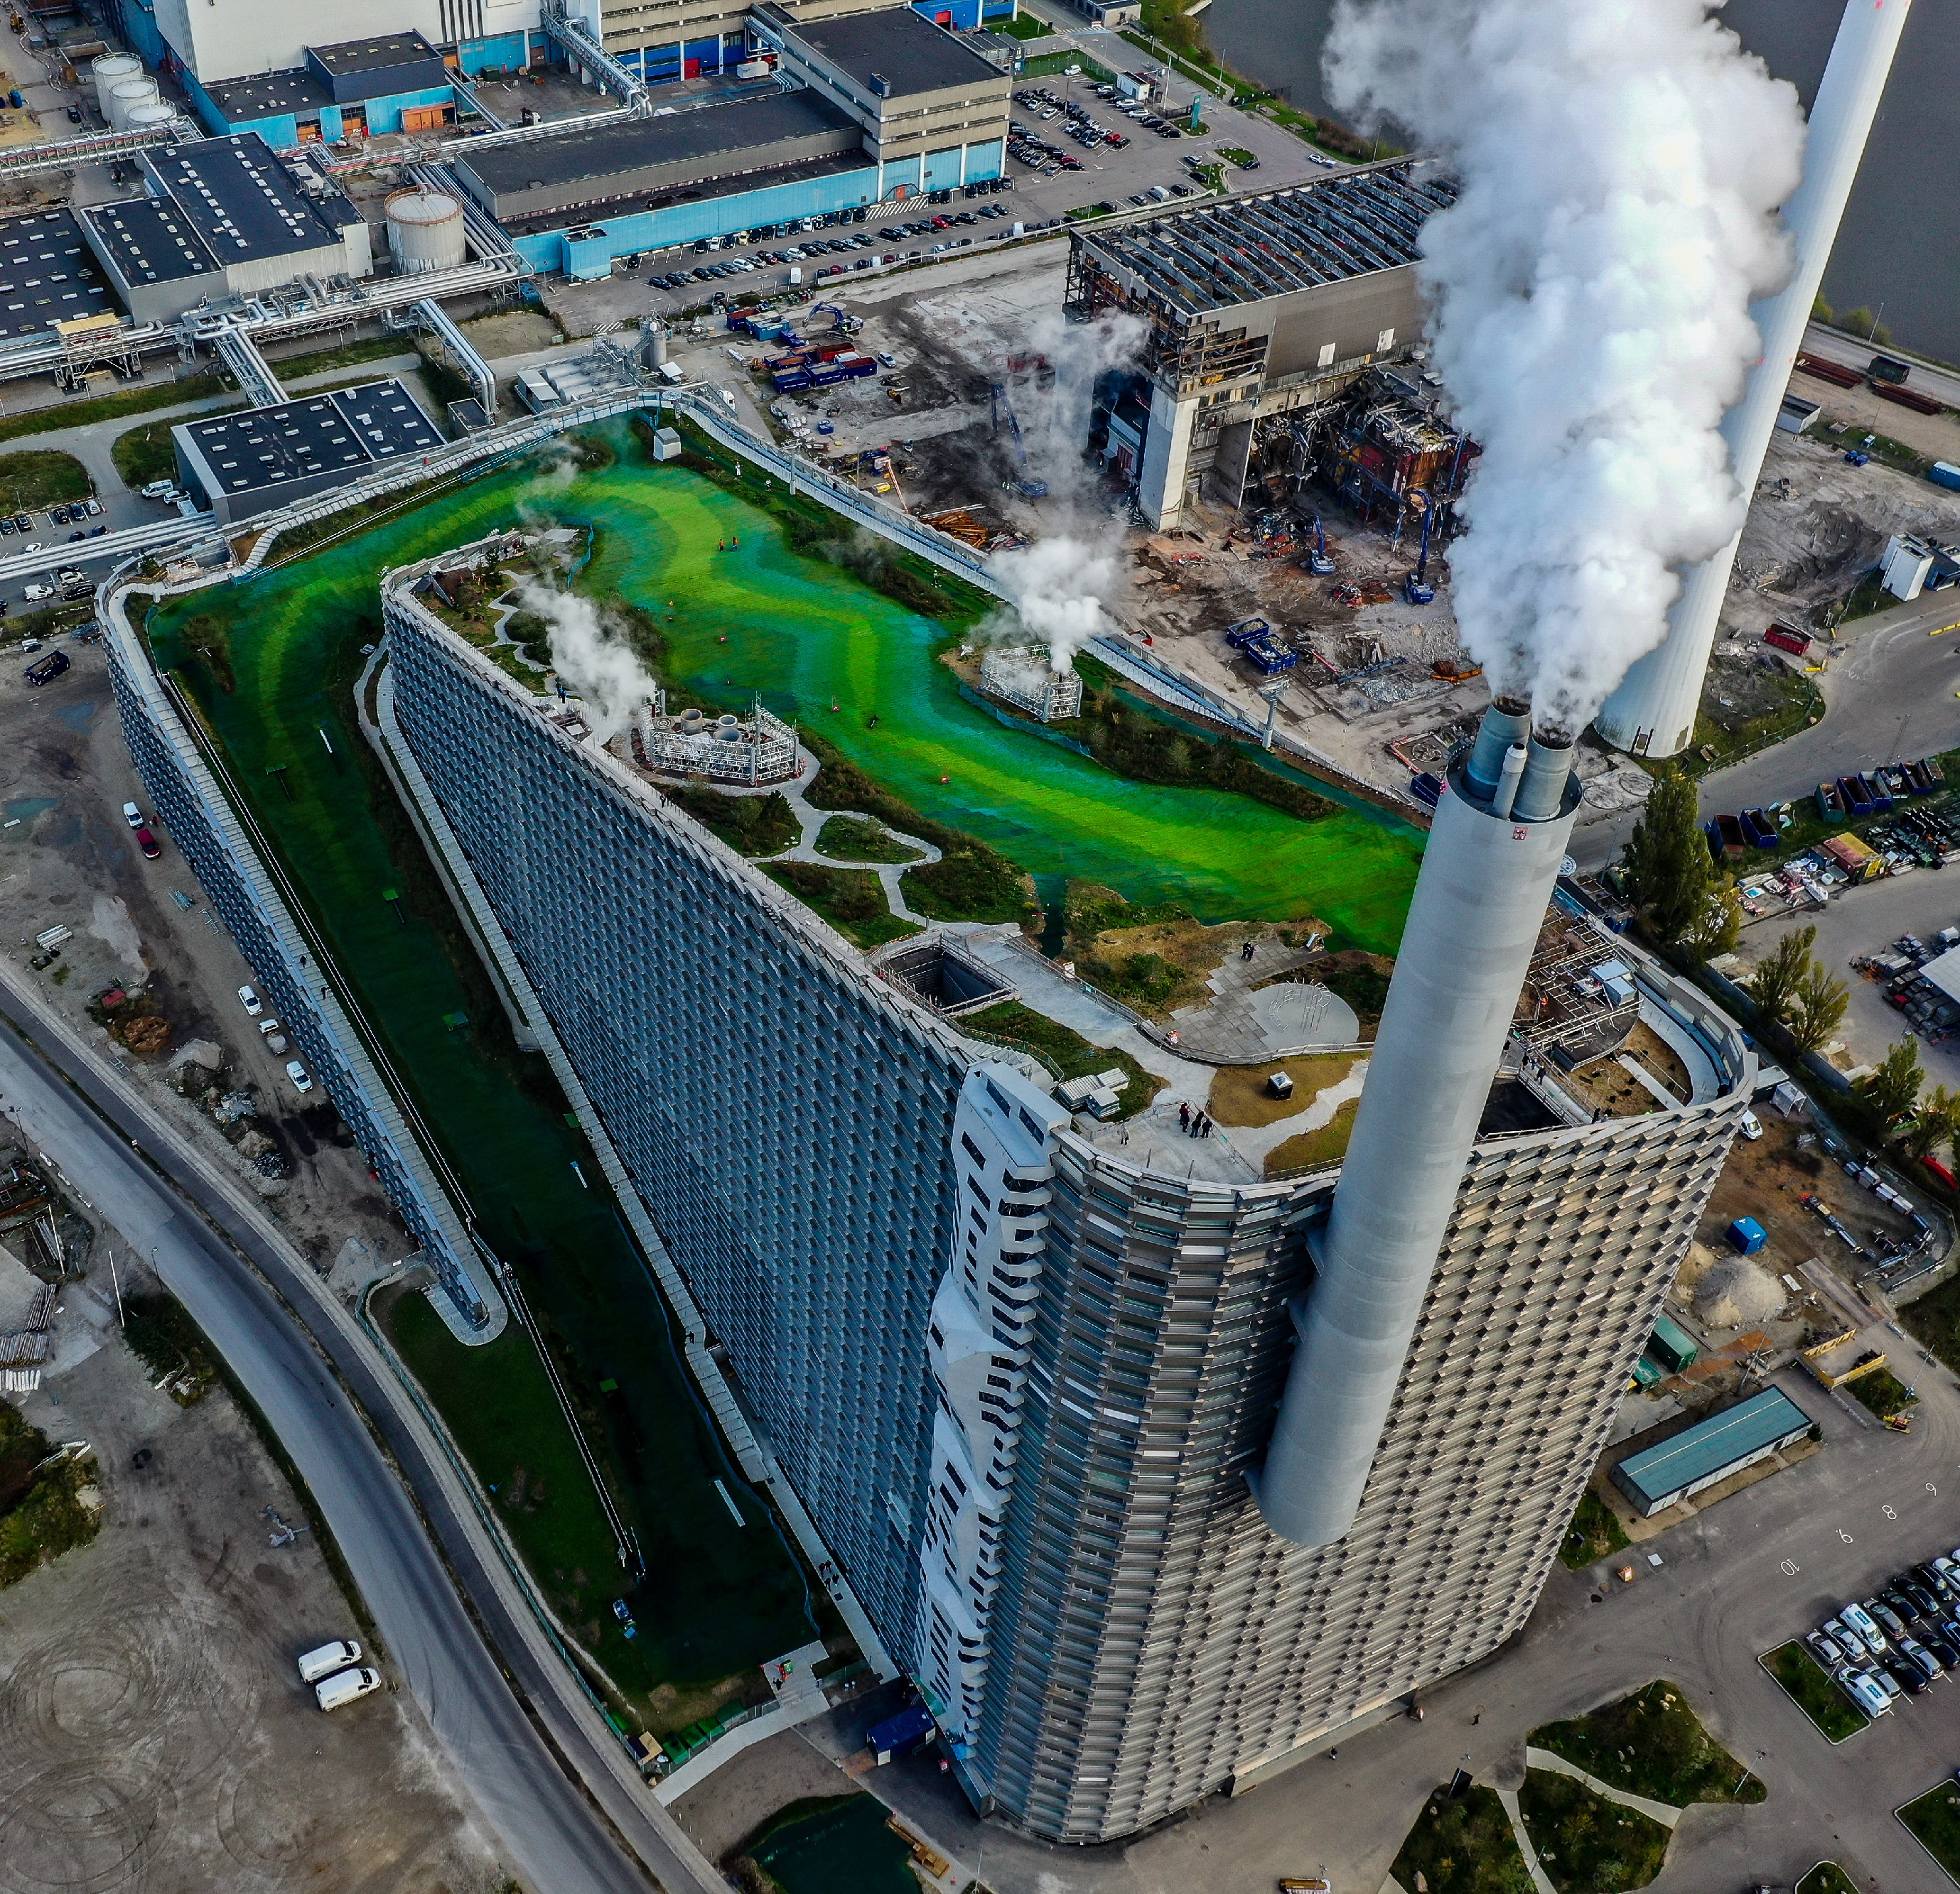
Case example 1: CopenHill
Sustainability │ Procurement │ Contract Management │ How to do it
Combined heat and power waste-to-energy plant and recreational facility.
560.000 tons waste per year processing capacity.
Plant can change between operating modes, producing 0-63 MW electricity and 157-247 MW district heating.
The recreational components have an attendance estimated at 42-57 thousand visitors annually.
Part of Copenhagen’s net zero 2025 plan.
Ramboll advised on various parts of the project.
Photo: Max Mestour og Amelie Louys
Source: ARC – https://a-r-c.dk/amager-bakke/

Slide 10
Case example 2: Aflandshage
Sustainability │ Procurement │ Contract Management │ How to do it
Coastal windfarm 10 kilometres south of Copenhagen.
300 MW effect when finished.
Goal of contributing to green transition.
Goal of utilising multiple aspects of the project for sustainability purposes – e.g., through the construction of artificial reefs as part of a “nature inclusive design”.
Ramboll is currently advising on various aspects of the project.
Source: https://www.energy-supply.dk/article/view/877476/fundamentertil_havvindmoller_skal_give_flere_torsk_i_oresund
Source: HOFOR – https://www.hofor.dk/baeredygtige-byer/vind-og-sol/nye-vind-og-solprojekter-paa-vej/nye-havvindmoeller-i-oeresund/aflandshage-vindmoellepark/

Slide 11
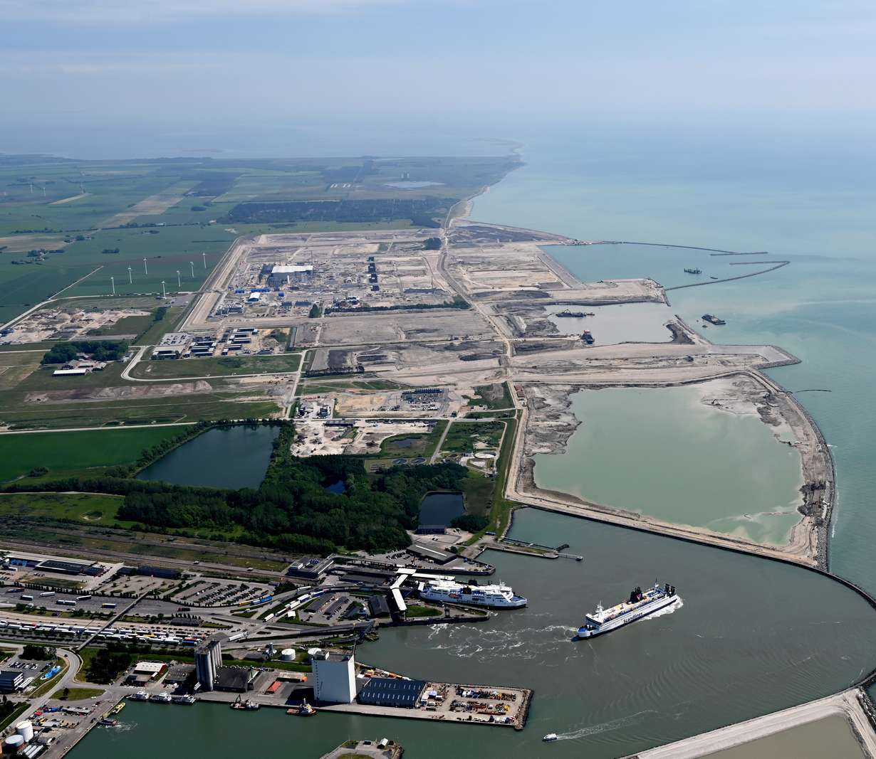
Case example 3: Fehmarn Tunnel
Sustainability │ Procurement │ Contract Management │ How to do it
The Fehmarn Belt Fixed Link tunnel will be the longest ever constructed immersed tunnel at a length of 17,6 kilometres.
Enabling traffic to use the shortest and fastest route will reduce CO2 emissions and free up capacity on roads and railways.
The contractors have committed to the establishment of at least 500 full-time apprenticeships.
To ensure optimal conditions for the 500 apprentices, the project will construct an apprentice city.
Ramboll is currently advising on various aspects of the project.
Source: https://jyllands-posten.dk/jperhverv/ECE13715028/fra-holte-til-roedbyhavn-for-en-laereplads-oktay-tas-kan-lide-stilheden/
Source: Femern – https://femern.com/da/baeredygtighed/baeredygtighed/

Slide 12
How Procurement can play a key role in integrating sustainability from an early phase of a project?
Sustainability in major projects - what does good look like?
How Procurement can play a key role in integrating sustainability from an early phase of a project?

Slide 13
Consider sustainability goals as an integrated part of the procurement process
Sustainability │ Procurement │ Contract Management │ How to do it
Step 1: Assessing sustainability topics in procurement routes
Step 2: Requirement suggestions for sustainability topics
Address how selected sustainability topics can be delivered by potential suppliers by considering the following elements:
Long-term initiatives
Technical aspects
Here-and-now integration of sustainability topics in tenders
Market perspective
Suppliers perspective
Based on these aspects, we recommend which topics to include in which procurement route
Contractual requirement
Minimum requirement
Evaluation requirement
Step 3: Balancing and executing on the sustainability goals
The procurement strategy harms competition significantly or project becomes too expensive
Formulate procurement strategy: Define which of the sustainability topics to include in the tender package, which goals they must meet and draft outline of the requirements supporting the selected sustainability topics. Also consider contract management during execution.
Prepare tender package and execute tender
The procurement strategy does not harm competition significantly or make project too expensive

Slide 14
Aligning sustainability policies/regulations – e.g., EU Taxonomy
Sustainability │ Procurement │ Contract Management │ How to do it
For many projects, it will become increasingly relevant to consider sustainability policies and regulations dictated by various authorities and organisations. One example is the EU Taxonomy.
For the projects to actually comply, these policies/regulations must be integrated from the early stages of the procurement processes.
This can be done through, e.g., the use of requirements and evaluation criteria.
Climate change mitigation
Climate change adaptation
Sustainable use of water and marine sources
Circular economy
Pollution prevention
Healthy ecosystem
The six environmental objectives established in the Taxonomy Regulation – please see more at https://c.ramboll.com/eu-taxonomy

Slide 15
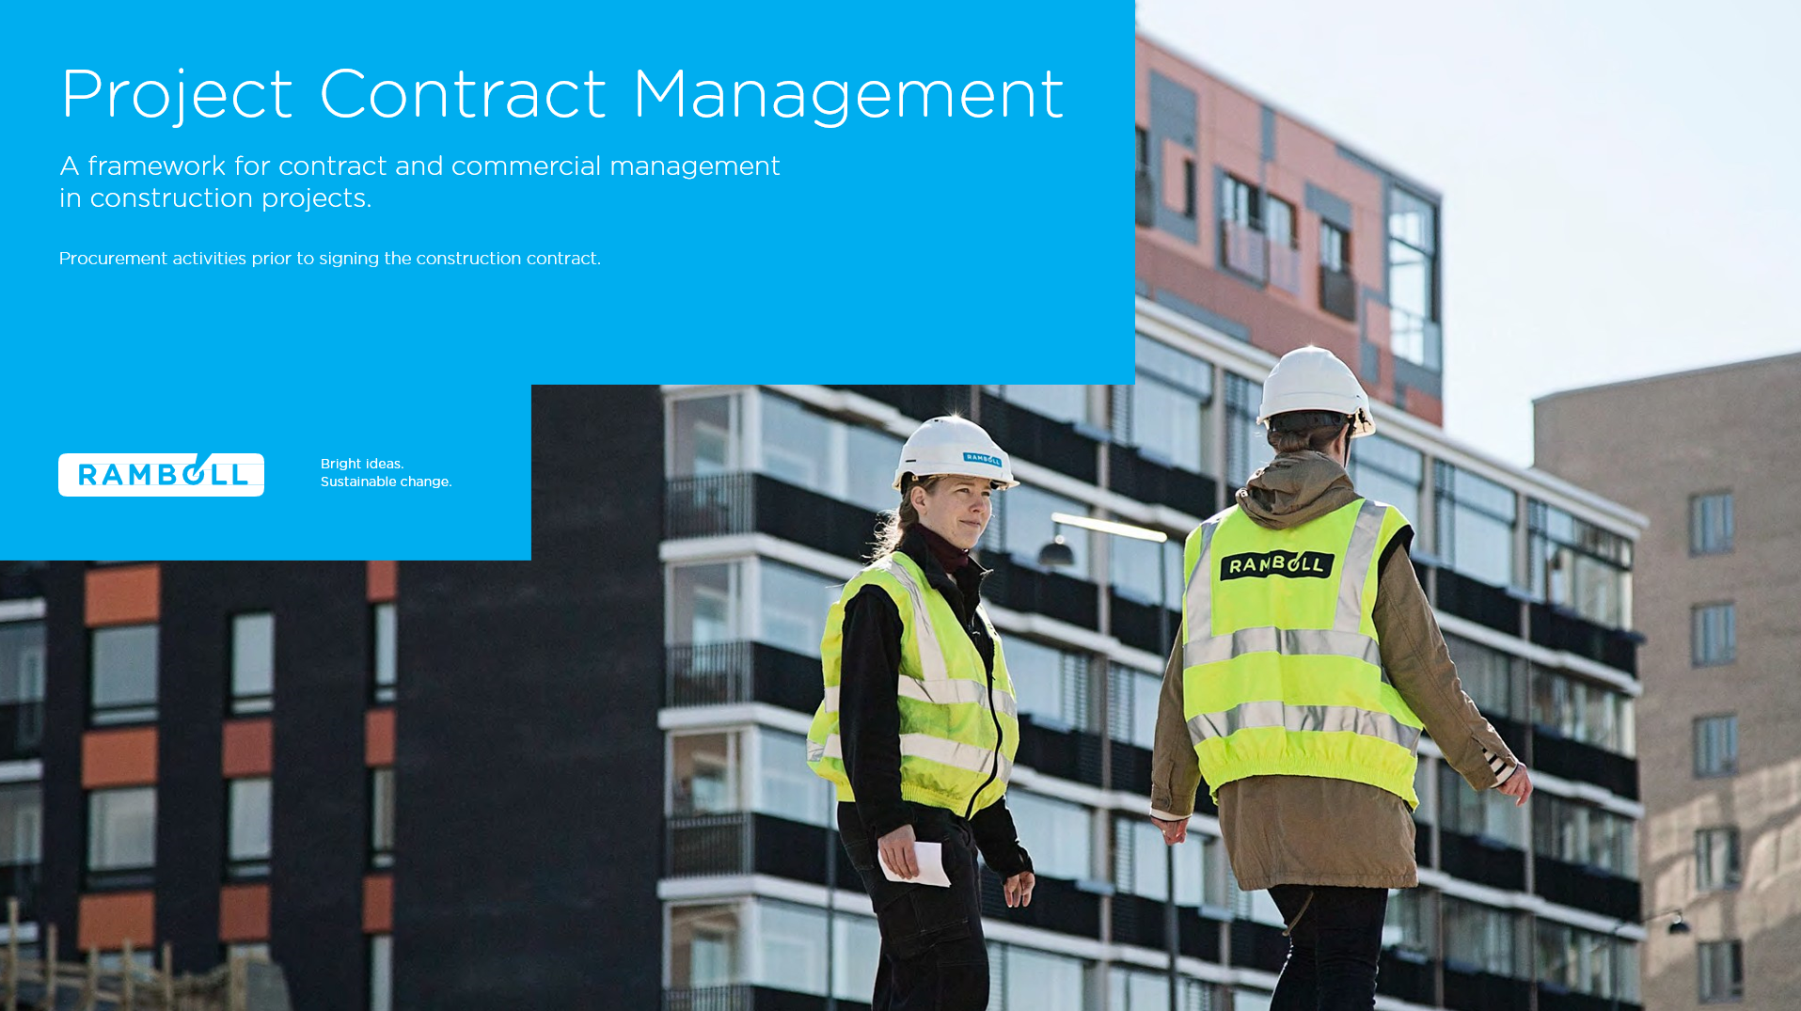
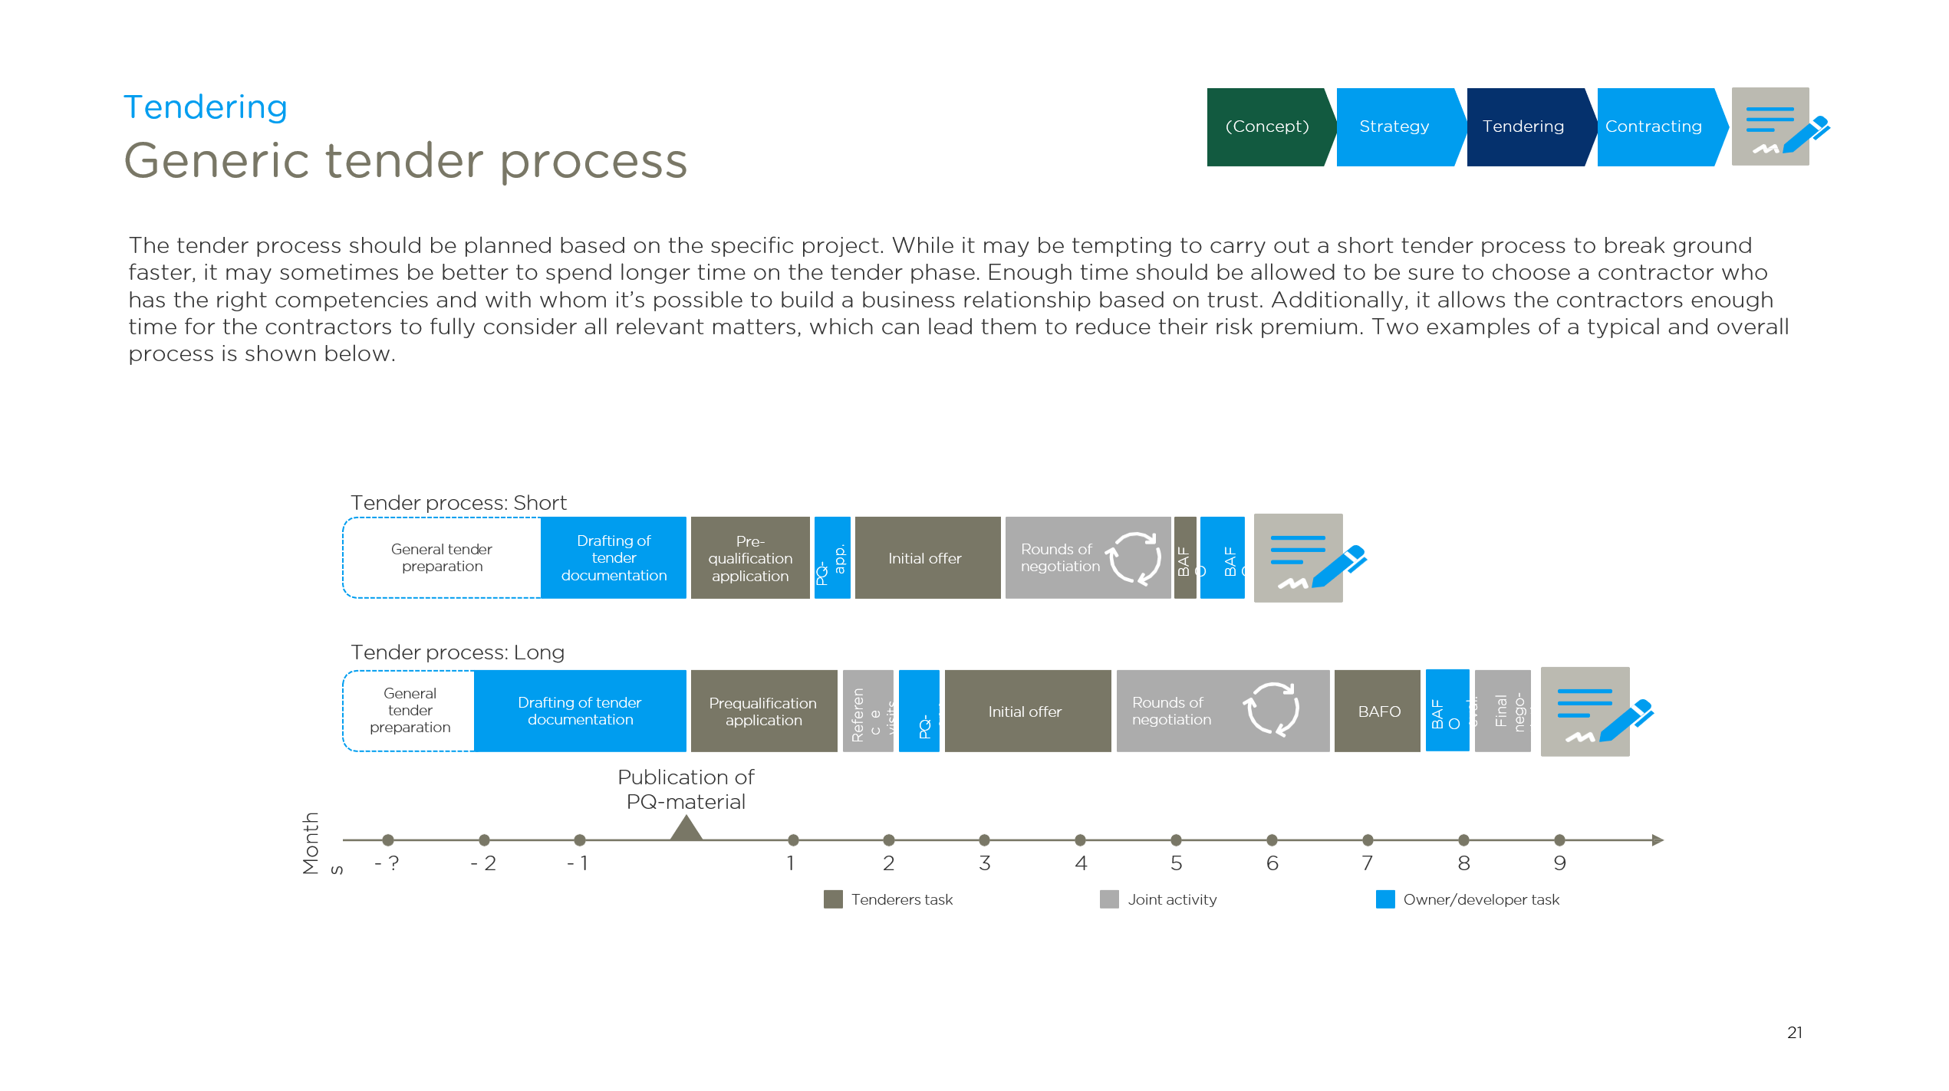
There are no secret tricks – it all comes down to good and consistent practices, which can be tough to maintain
Sustainability │ Procurement │ Contract Management │ How to do it
QR-code for whitepaper shown below
Procurement activities prior to the signing of the contract
https://c.ramboll.com/project-contract-management-white-paper

Slide 16
How Contract Management can support the realisation of a project's sustainability objectives?

Slide 17
Why do contracts need to be managed?
Sustainability │ Procurement │ Contract Management │ How to do it
Contracts are not self-fulfilling prophesies but need to be actively managed to ensure that the original contract goal is reached.
Sustainability initiatives are often considered “nice-to-have” and therefore sustainability is primed to be a focus for contract management efforts.
Contract management is a fluid discipline, which is defined differently across different projects. To the right are examples of potential contract management tasks.
Contract administration
General document management
Ensuring that written deliverables, critical correspondence and other documents of contractual importance.
Delivery & Obligation administration
Maintaining D&O overview and ensuring allocation of ownership and thereby minimising risk of non-compliance.
Variation order and claims administration
Drafting and administering documentation for contractual changes, ensuring compliance and thereby entitlements.
Financial administration
Assisting the project in management of the payment's procedures and maintaining financial overview.
Contract management
Delivery & Obligation management
Management of the D&O process within the project by ensuring all parties D&O compliance as specified in the contract.
Variation order and claims management
Managing variation orders and claims efficiently and in compliance with the contract to protect the contract value.
Financial management
Providing timely forecasting of cashflow and contingencies, based on current and future contractual development.
General contract advisor
Operational and tactical advisory on contractual and legal matters to project management, ensuring that contractual and legal advice is easily available at project management level.
Commercial management
Dispute management & resolution
Managing contractual disputes when they have been escalated or expected to be escalated out of the daily collaboration levels.
Portfolio management
Assisting in managing the multiple contracts related to the execution of the overall project/programme – both upstream and downstream in the supply chain.
Strategic advisor
Providing commercial advice to the entire project in matters such as negotiations, key stakeholder management and matters affecting the business case.

Slide 18
Structured approach to managing sustainability initiatives throughout contract execution
Sustainability │ Procurement │ Contract Management │ How to do it
1
2
3
Extract sustainability initiatives from the contract
Continuously follow-up on contract compliance throughout execution
Document results and handover to operations
In practice, it can be done in many ways – one way is an obligation tracker
ID | Clause | Clause title | Contract Document | Contract wording | Responsible | Executing | Approver | Frequence | Start date | End date
1 | 4.2 | Procurement of Renewable Energy | Contract Agreement | The Contractor shall procure that 100% of the electricity supplied to it during the term of this Agreement is Wholly Renewable Energy. | Contractor | Procurement manager | Project Manager | One-off | 01-10-2022 | 29-10-2024
2 | 12.1 | Circular Design Obligation | Employer’s Requirements | The Contractor shall prepare a design of the Project to deliver the Specification for the Client. In creating the design for the Project, the Contractor shall use all reasonable endeavours to satisfy the Circular Design Requirements. | Contractor | Project Manager | Project Manager | One-off | 01-11-2022 | 01-11-2022
3 | 4.4 | Product Carbon Footprint | Annex 1 | The Contractor shall reduce the Product Carbon Footprint by no less than the percentages shown at Annex 1 to this Agreement in each period to which a Greenhouse Gases Report relates. | Contractor | Contract Manager | Project Manager | Monthly | 01-11-2022 | 29-11-2022
4 | 4.8 | Annual Emissions Report | Annex 1 | The Contractor shall set an Emissions Target and provide the first Annual Emissions Report within 12 months after the start date of this Agreement and each other Annual Emissions Report no later than forty (40) Business Days after the applicable Emissions Report Date. | Contractor | Contract Manager | Project Manager | One-off | 01-11-2022 | 22-11-2022
Source – clause examples: https://chancerylaneproject.org/climate-clauses/

Slide 19
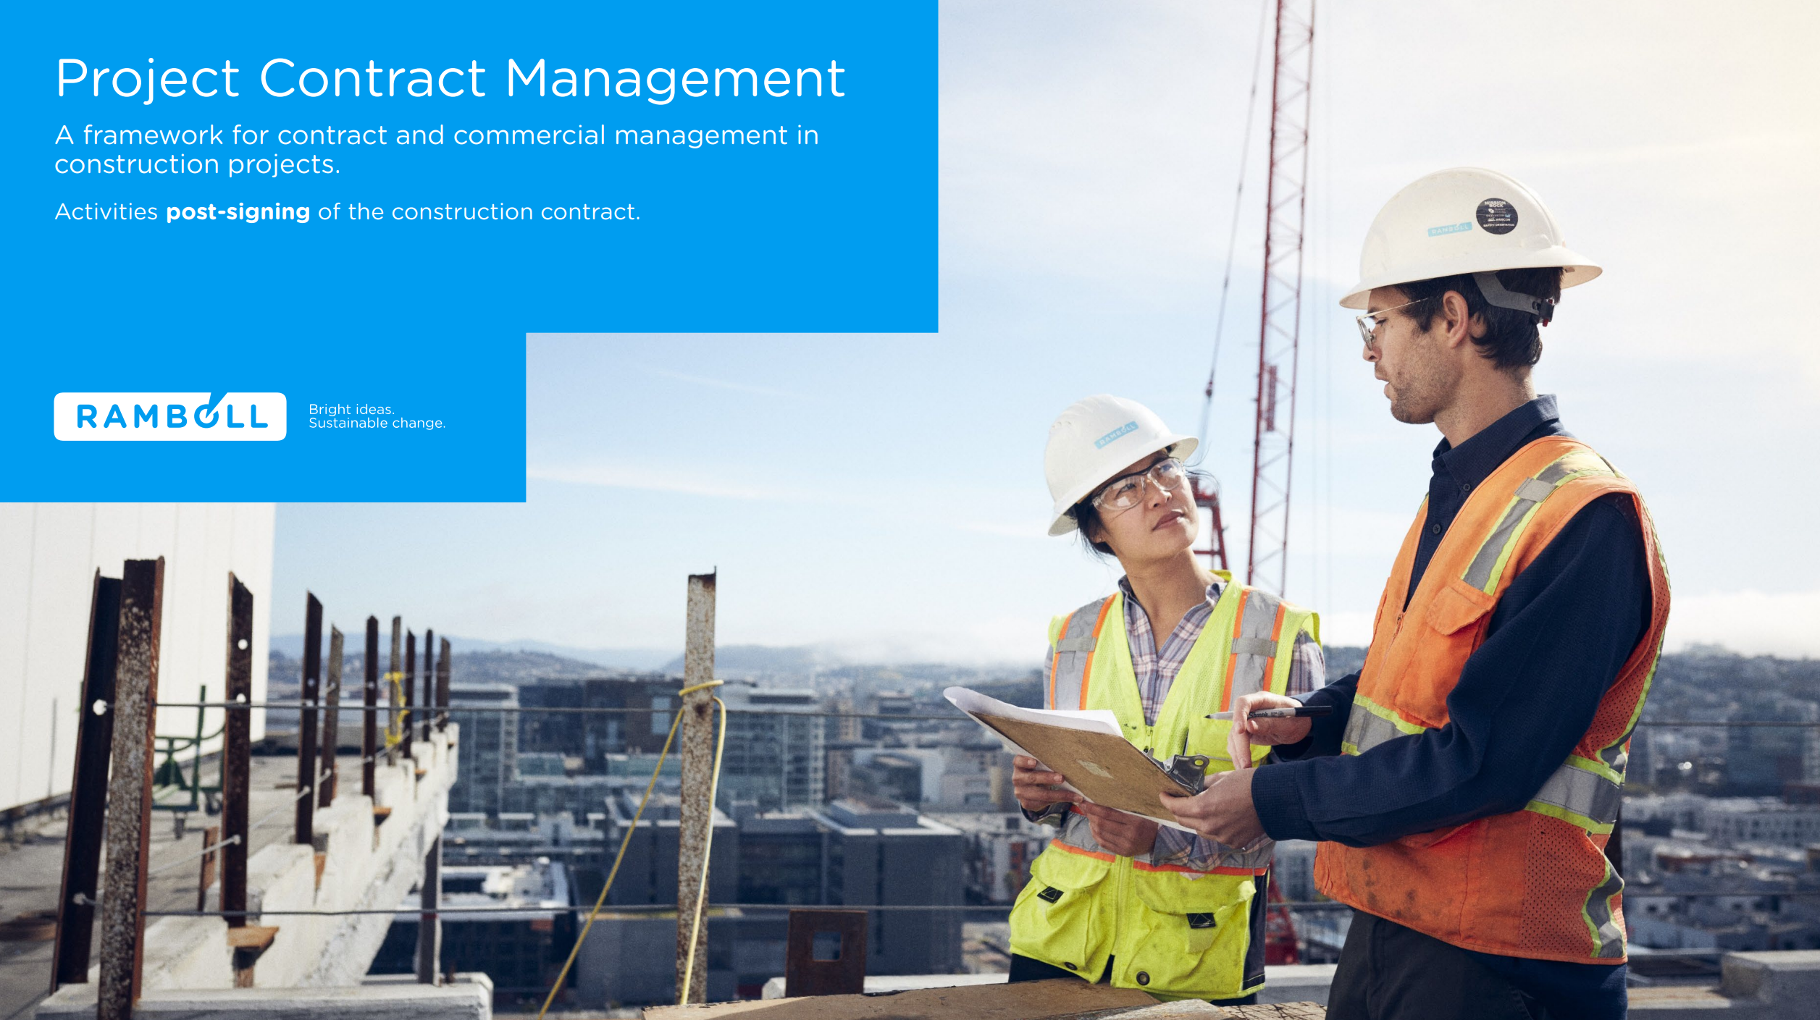
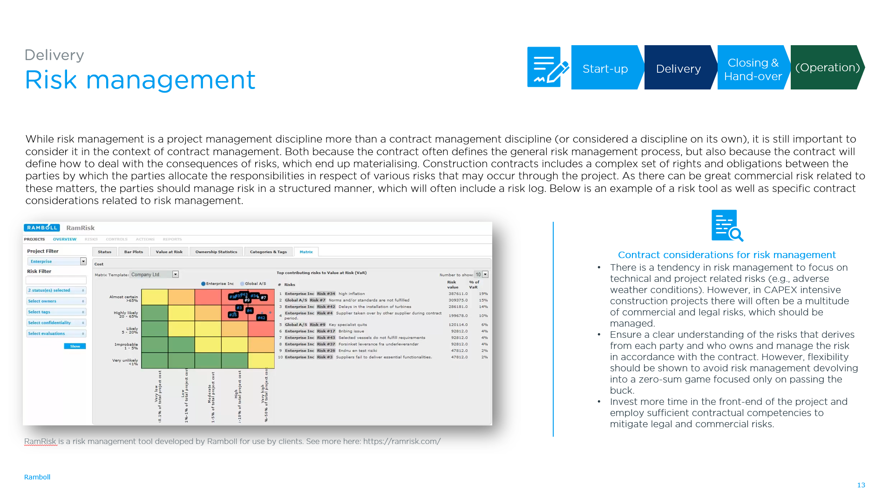
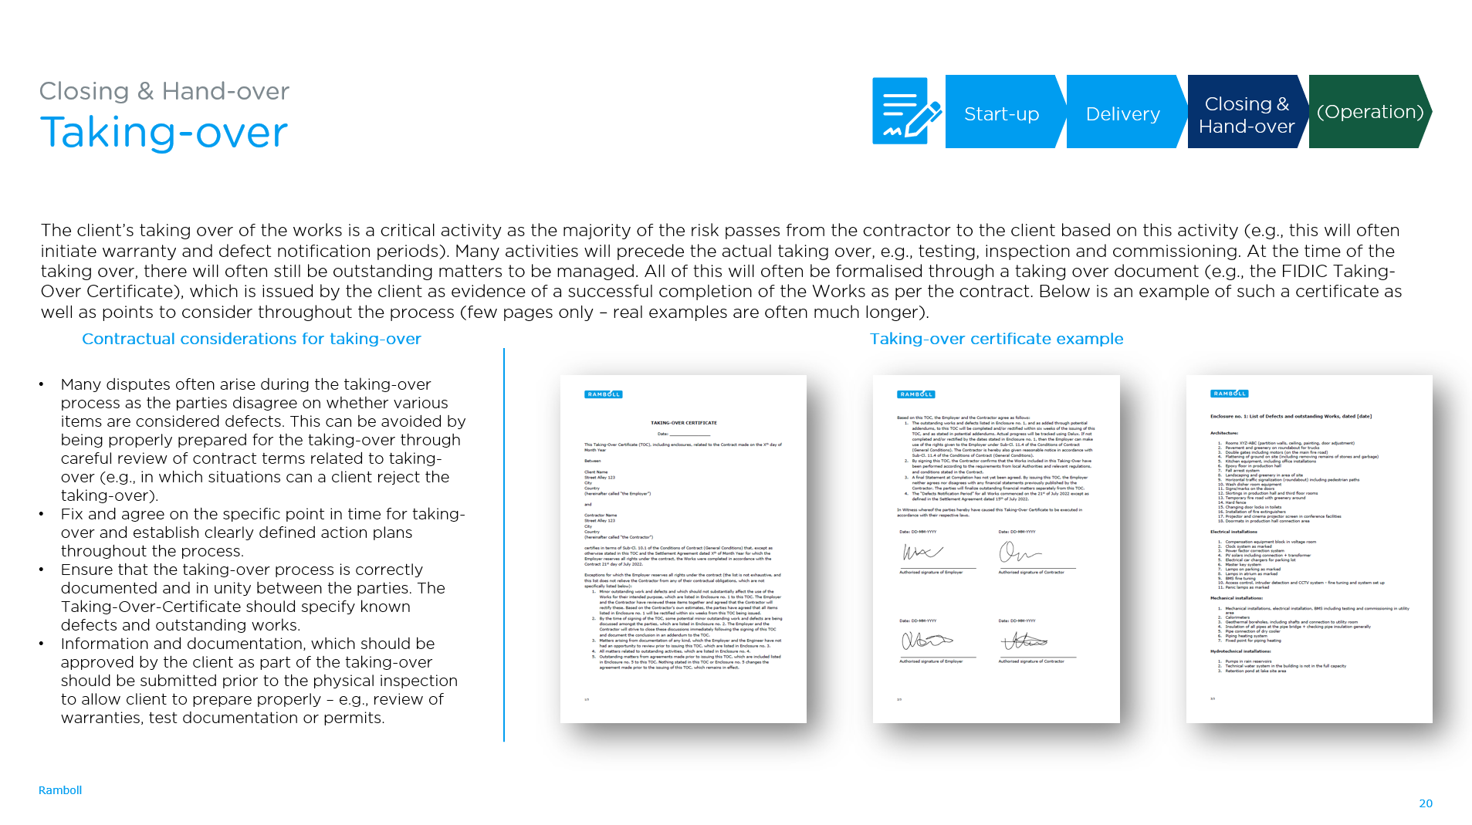
There are no secret tricks – it all comes down to good and consistent practices, which can be tough to maintain
Sustainability │ Procurement │ Contract Management │ How to do it
QR-code for whitepaper shown below
Activities post-signing of the contract
https://c.ramboll.com/project-contract-management-post-signing

Slide 20
How to put sustainability on the agenda in your project?

Slide 21
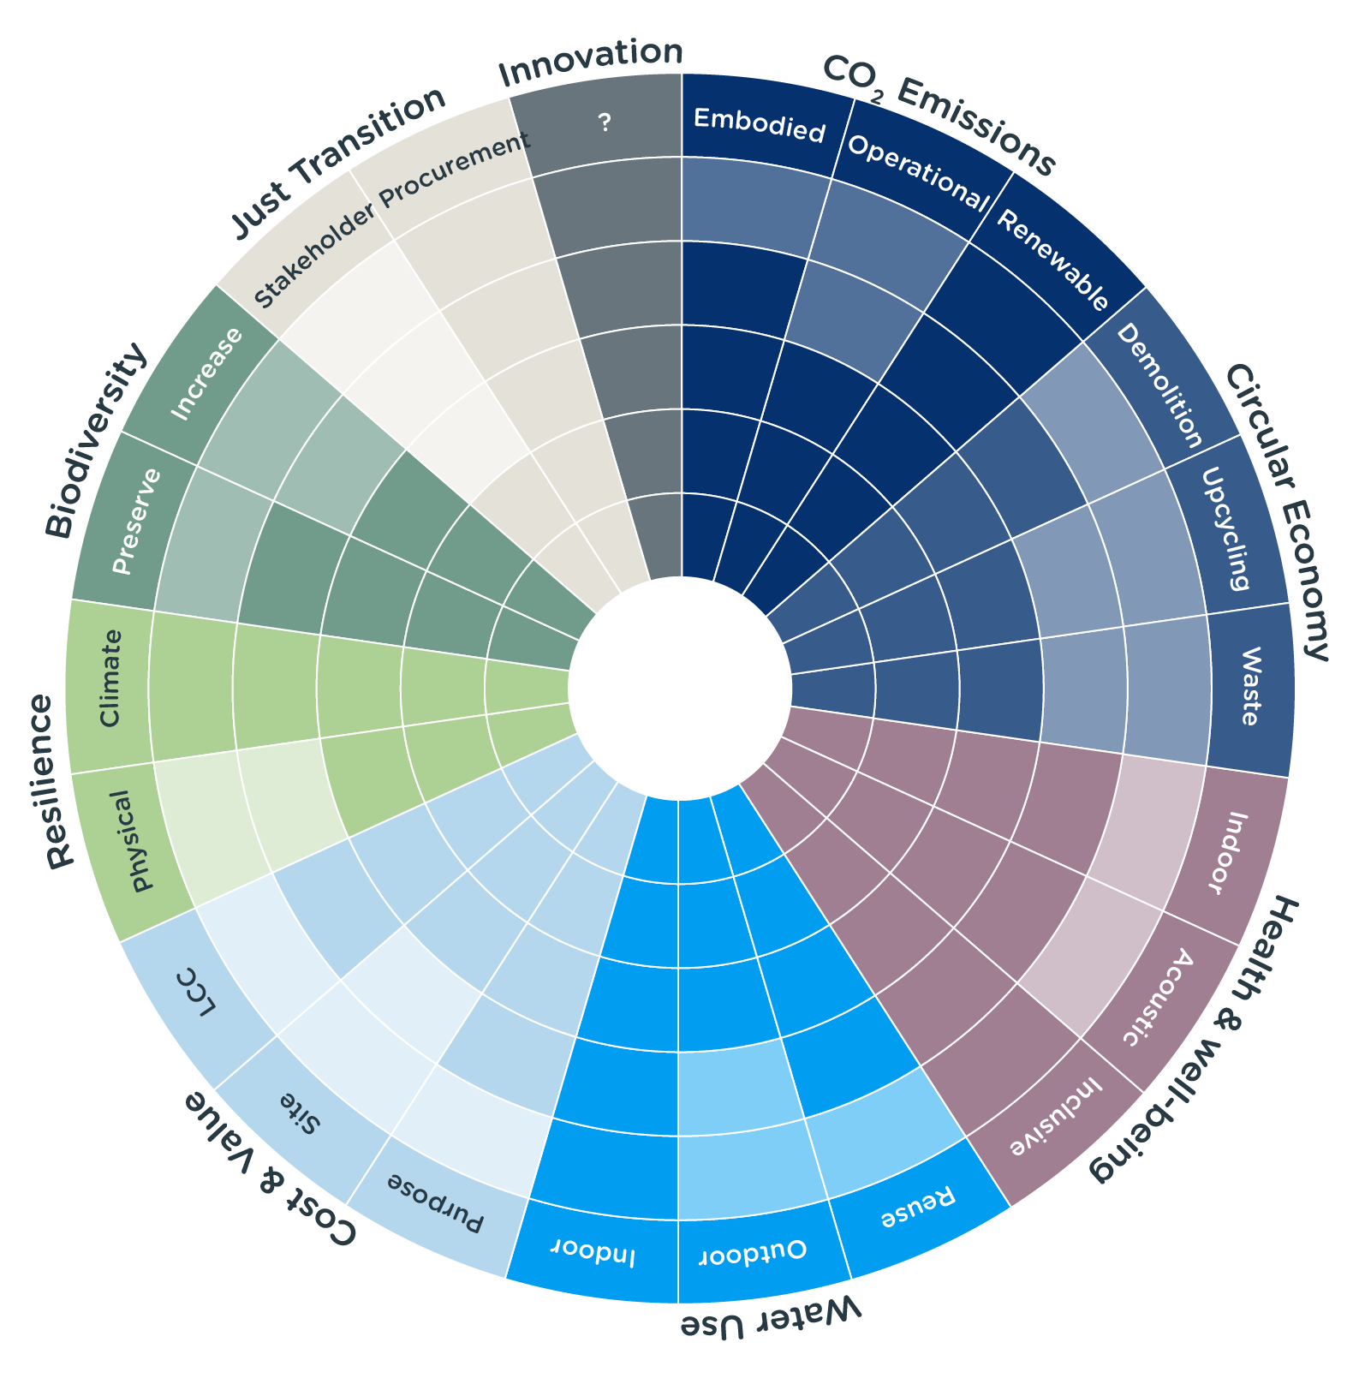
Sustainability often starts with a broad dialogue before it is narrowed down to specific initiatives
Sustainability │ Procurement │ Contract Management │ How to do it
Sustainability can have many forms across different types of construction project. To facilitate the sustainability dialogue and to cover all of the aspects, Ramboll has developed the sustainability dialogue tool: https://ramboll.com/ingenuity/sustainability-toolbox
The various subjects discussed through the sustainability talk will often become sustainability requirements in the contract. For these requirements to be realized, diligent contract follow-up is often needed.

Slide 22
Thank you for your time…
…questions?
René Søegaard
Director
Legal & Contract Management Consulting
T +45 51611445
rsoe@ramboll.com
Lars Boe Riber
Manager
Legal & Contract Management Consulting
T +45 51613570
lbri@ramboll.com

