Slide 1
Securing Project Predictability
Lidia Stepanyuk
November 2022

Slide 2
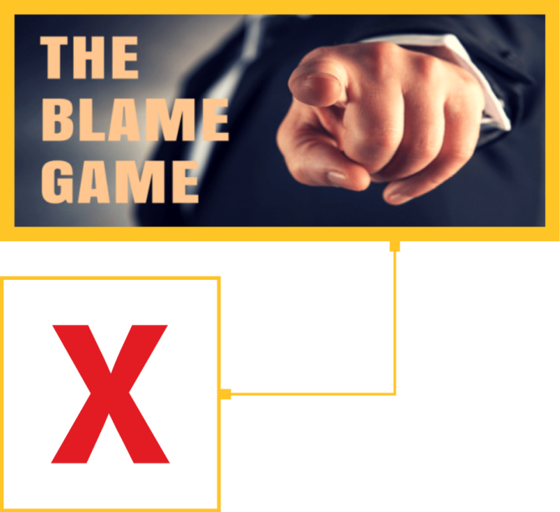
Why Are We Here?
Not to give one-fits-all solution, but to share Fluor journey to achieve project predictability

Slide 3
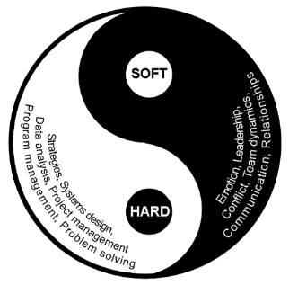
Why Are We Here?
Excellence in project execution – realistic start?
Project Predictability through:
Systems/Benchmarks
Team Maturity
People at the Center
What are we doing at Fluor?

Slide 4
Excellence in Project Execution Realistic Start?

Slide 5
Excellence in Project Execution – Realistic Start
Realistic Estimate
Right “Partner”
Contract Terms
GOOD
GOOD
+ FAST
NOT CHEAP
GOOD
+ CHEAP
NOT FAST
FAST
+ GOOD
+ CHEAP
IMPOSSIBLE
FAST
CHEAP
FAST
+ CHEAP
NOT GOOD

Slide 6
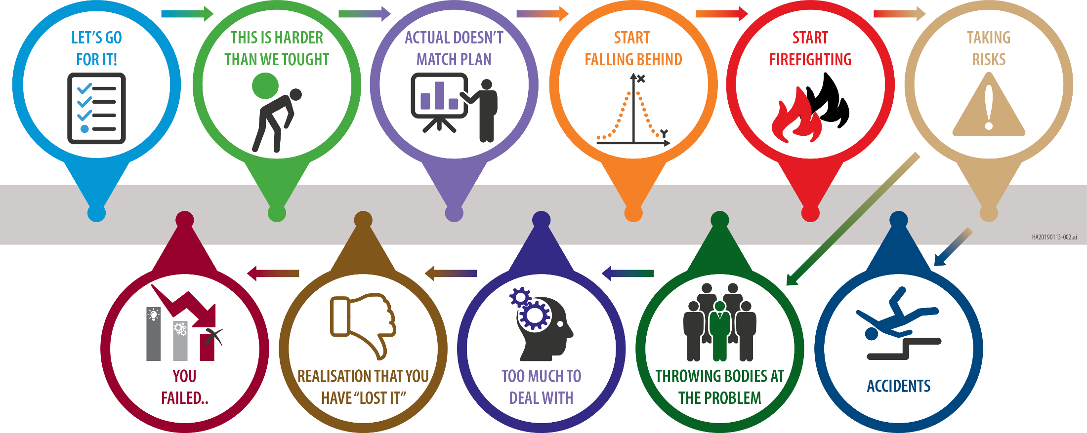

Slide 7
Starting Point
What do we see…
HA20220446-001

Slide 8
Project Predictability Through
Systems/Benchmarks
Team Maturity

Slide 9
Monitoring
Team Maturity
Realistic
Reporting
Team
Dynamic
Key
Focus
Areas
Predictive
Analysis
Commitment
HA20220485-001
9

Slide 10
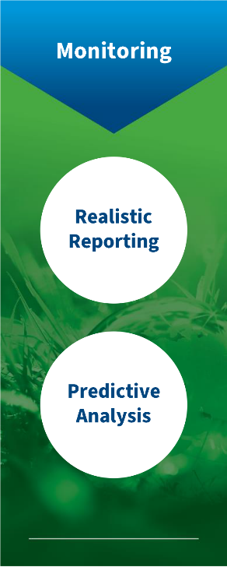
EPHD Journey and Value Delivery
2021
Drive the use of EPHD on more Projects, train project team members
2020
Analysis continuing & Status – 100+ Historical projects, 15+ High risk projects
2017
2017 - 2019
40+ Project deep dive analysis to senior leadership, extensive data analysis to identify key issues in execution, support of project decisions, proposals
2016
EPHD UI
2014
1
2
POC Completed
2013
Vision & Idea
Data Collection for POC Kick off
Q1
Q2
Q3
Q4
Notes:
UI – user interface

Slide 11
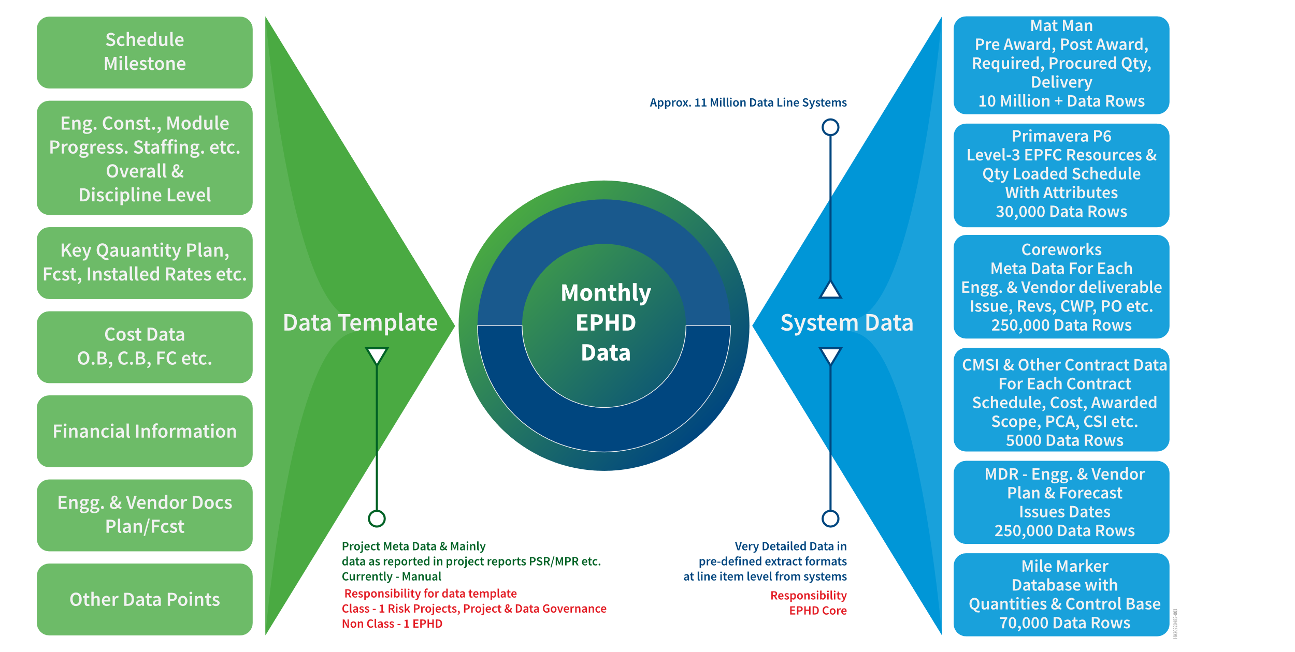
EPHD data collection
Analytics is the easy part, data and the quality thereof, is the biggest challenge

Slide 12
EPHD

Slide 13
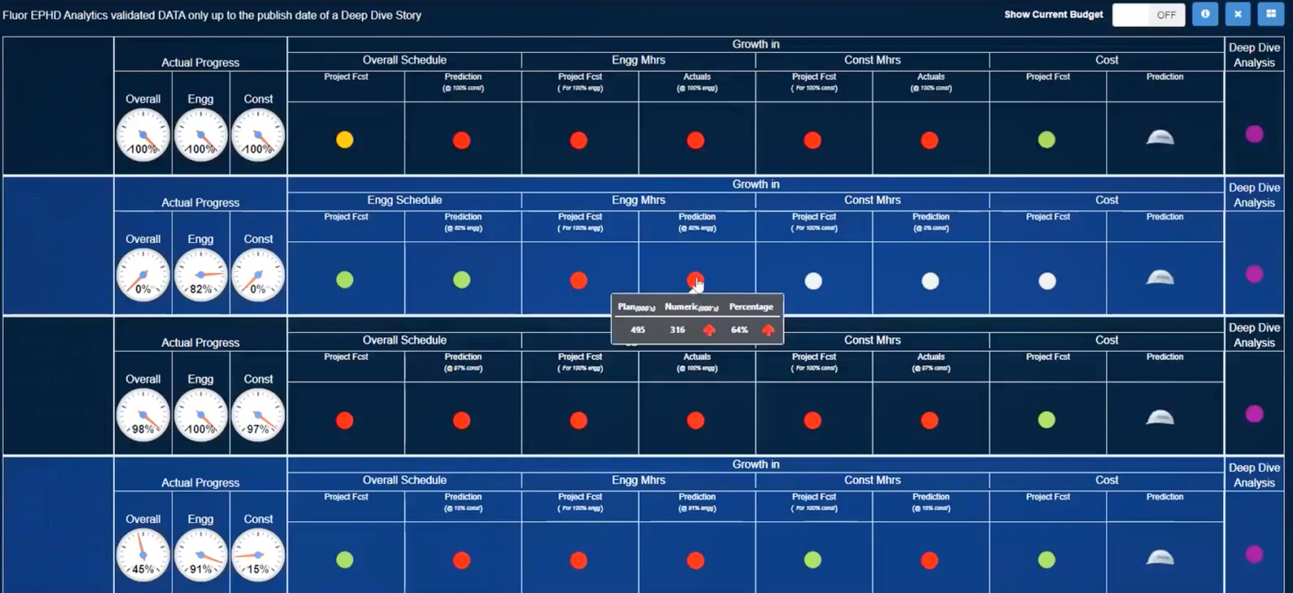
EPHD
Project A
RIM
Project B
RIM
Project C
RIM
Project D
RIM
Notes:
Left – what project is forecasting & right column is what predictive analytics tells us

Slide 14
EPHD
Notes:
How does the project compare to the benchmarks and to the specific projects (analysis is one click away!)

Slide 15
EPHD

Slide 16
Project Predictability
Team Maturity
EPHD

Slide 17
One Project One Team! - COLLABORATION!
Understanding Values, Culture, Work Processes
Team Commitment: Plan the work and work the plan!
Team Maturity
Team
Dynamic
Kick-Off Meetings
Commitment
Team Building Activities
Collaboration and Safe Environment!

Slide 18
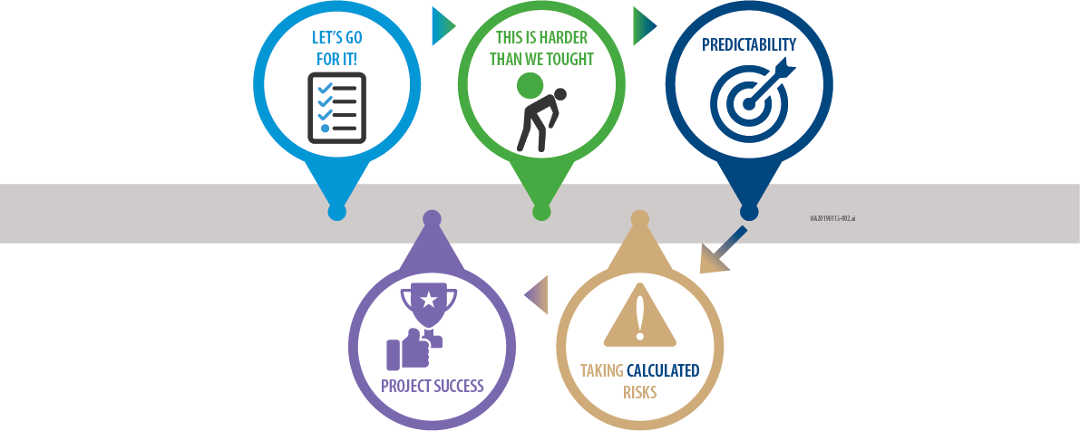

Slide 19
People at the Center – What are we doing at Fluor?

Slide 20
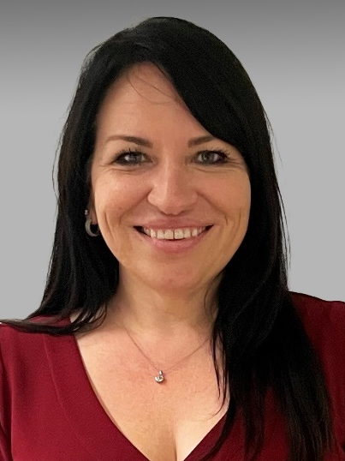
Contact Information
Lidia Stepanyuk
Office Lead, People and Culture - Project Management, Project Controls & Estimating
lidia.stepanyuk@fluor.com
+31 (0)23 543.2544

