Slide 1


Unlocking Project Performance
Really collaborating to deliver enhanced performance on today’s major projects
Amsterdam - November 2022

Slide 2
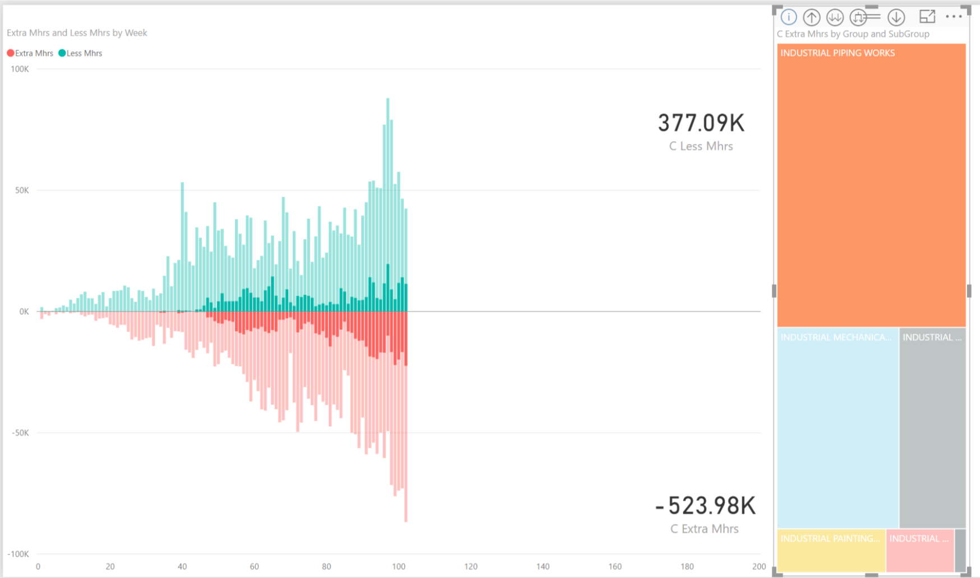
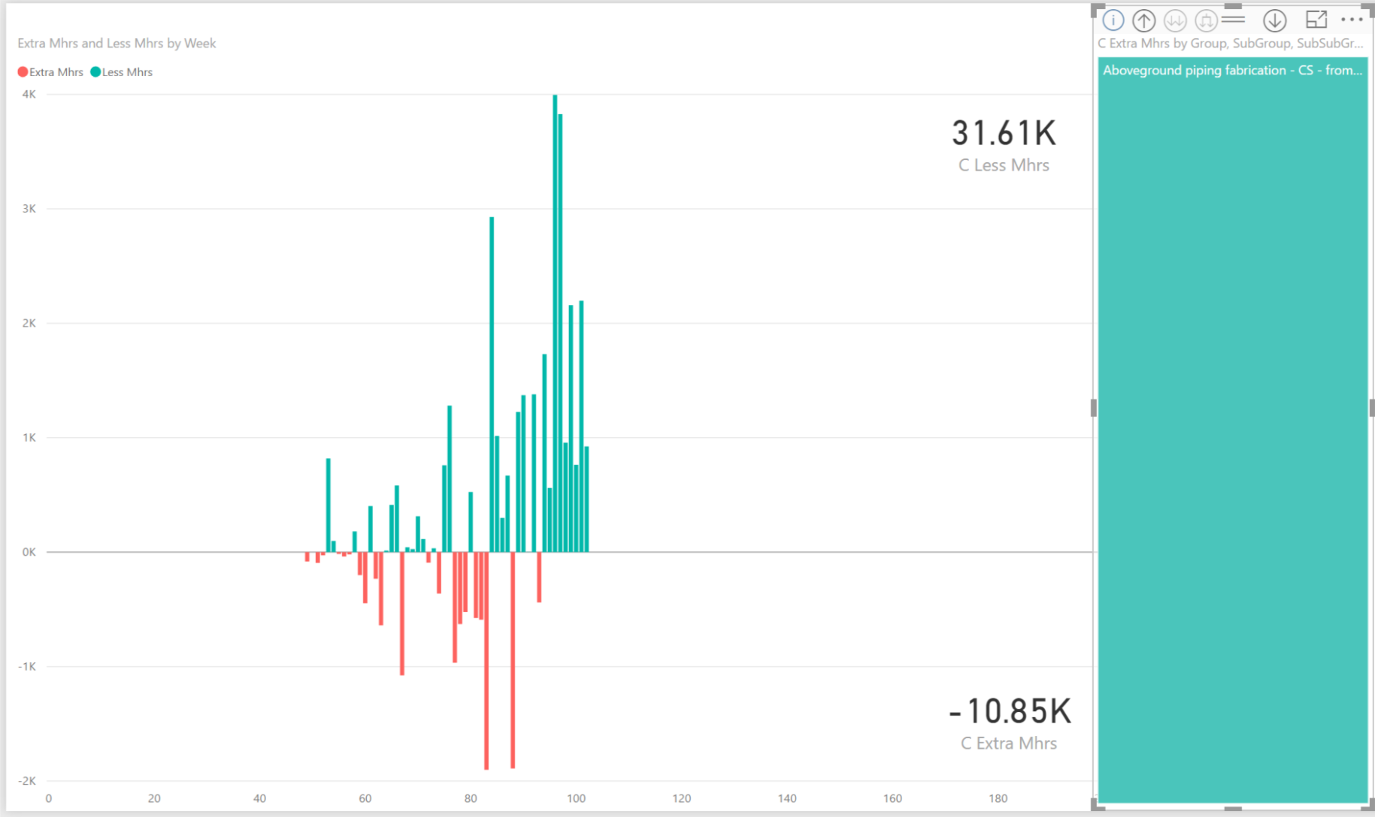
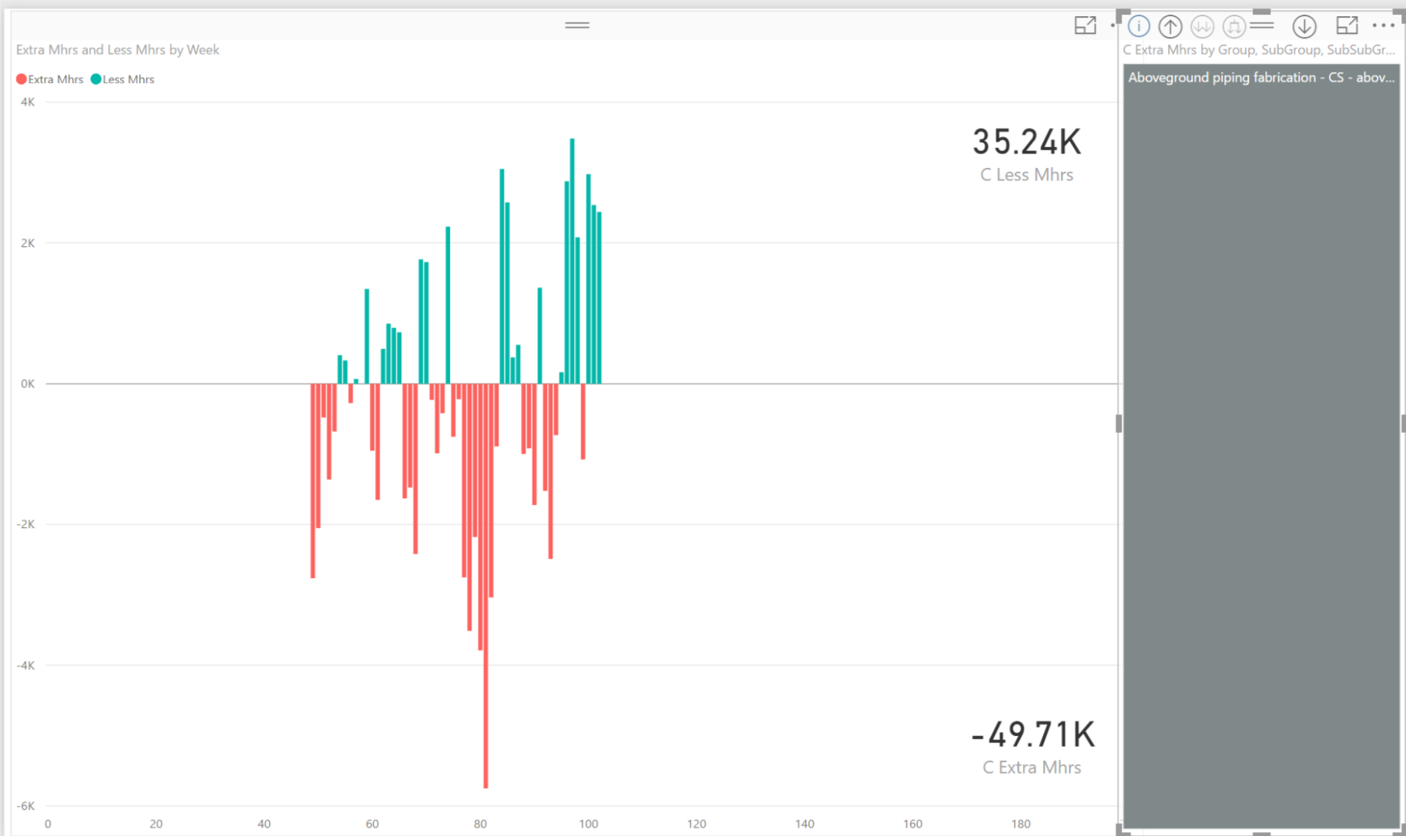
Projects leave serious money on the table – everyday!
Productivity at 50% through a $4bn GTL Plant Build
Projects are almost naturally set up to under-perform
Estimates
Contracts & Incentives
Ever changing activities
Immature teams
Accounting based reports
This is good news!
Because the opportunity to over-deliver is typically really big!
8m hours into project
CPI = 1.01
~1m hours over-performance
~1m hours under performance
15+% performance left behind
Above ground fabrication CS Pipes
… 2 to 10 inch
… above 10 inch

Slide 3
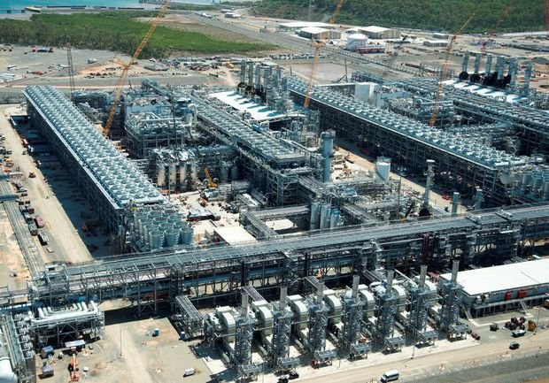
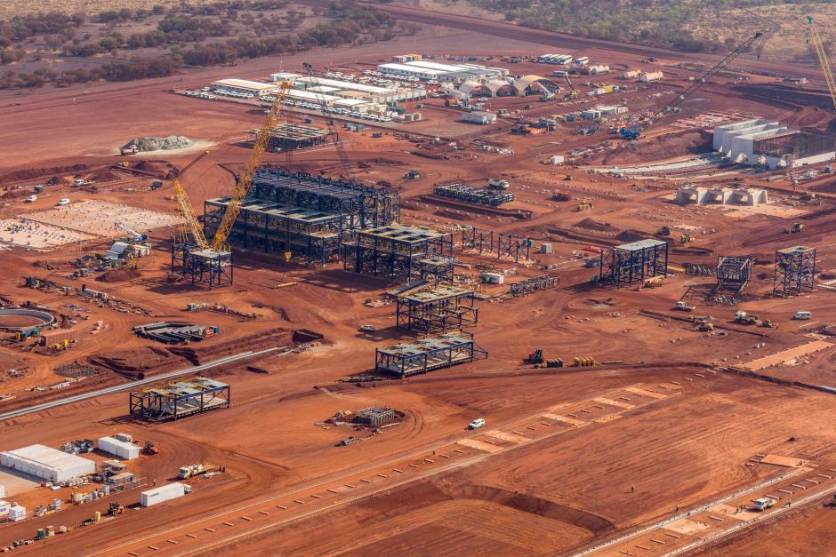
With project values at $1m a day – performance counts!
$22bn Gas Project
Project Value $1.6b
Engineering 3 mths
Permitting 3 mths
Construction 8 mths
Sourcing $45m
Commissioning 6 mths
$8bn Mine Project
Significant Savings Can Be Achieved
Bulk Earthworks 5 mths
Structures 2 mths
Tailings Dam 3 mths
M&E 4 mths
Concrete 2 mths
Systems 4 mths

Slide 4
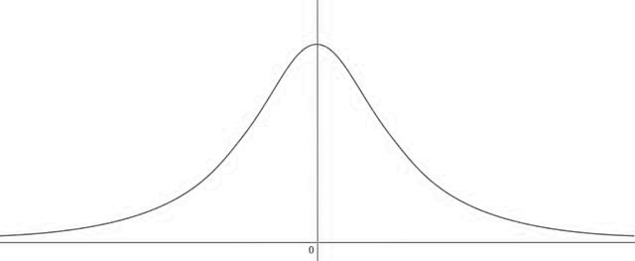
We see collaboration as key to capturing this performance jump
All project participants must shift from “safe plan for us” to “best result for all”
While ensuring that:
It’s sort of complicated out there…
…which gets in the way of performance
Project objectives are still met
Trade-offs being made are appropriate
Schedule Estimates
Owner
Needs
Collaboration
Driven by
Disconnection
Engineers
Project Mgmt
Challenge assumed dependencies
Ask how internal steps to be converted to external steps
HS&E
Faster
Slower
Controls
Contracts
Suppliers
Collaboration must be grown
Right partners
Right team & mindset
Right incentives
Everyone can win
Authorities
Trust that is built
Early engagement
Transparency
Stability
Eliminate non-productive time
Substitute processes to shorten duration
Implement more efficient operating procedures
Add resources
Site
Contractors
Other Packages
Notes:
Collaboration: Change the contractual structure, working relationships and overall incentives within the project team and across the supply chain from focused on defending a “safe” “public” schedule to engaging early and constantly to drive down schedules and increase rates – to beat the schedule – every day

Slide 5
We have found five areas that drive collaboration & performance
1
Strong Intelligent Owner Teams
  Make the right decisions early enough
Incentivise to Perform Together
2
  Set-up the commercial environment to drive for better every day
  Real time information transparency across the project & its supply chain
One Digital Environment
5
Making Collaboration Work
Empower the Frontlines
3
  Performance comes from frontline – Release and enable them
Proactive Supply Chain Management
4
  Significantly enhanced understanding and proactive management of the supply chain

Slide 6
Strong Intelligent Owners Teams
Make the right decisions early enough
1
Know what we specifically need
Understand the complete value trade offs
Intelligent
Recognise the value of time and timely decisions
Understand what will make each party successful
Realise they ultimately hold all of the risk
&
Fully informed on the status of work
Drive the best decisions for the project on time
Strong
Builds and protects a common performance culture
Drive performance for the benefit of all
Remove risks early enough

Slide 7
Incentivise to perform together
Set-up the commercial environment to drive for better every day
2
Part of the Team
Early & Committed
Bringing in Ideas
Succeed not just Deliver
Aligned Incentives across Project Team
Mutual Transparent
Want to Beat the Plan
Common data environment
Common systems
Systems that help
Setup to Win Together
Progress
Performance
Improvement
Behaviours
Shared data, knowledge, needs and issues
Right Regular Incentives
Business & Personal

Slide 8
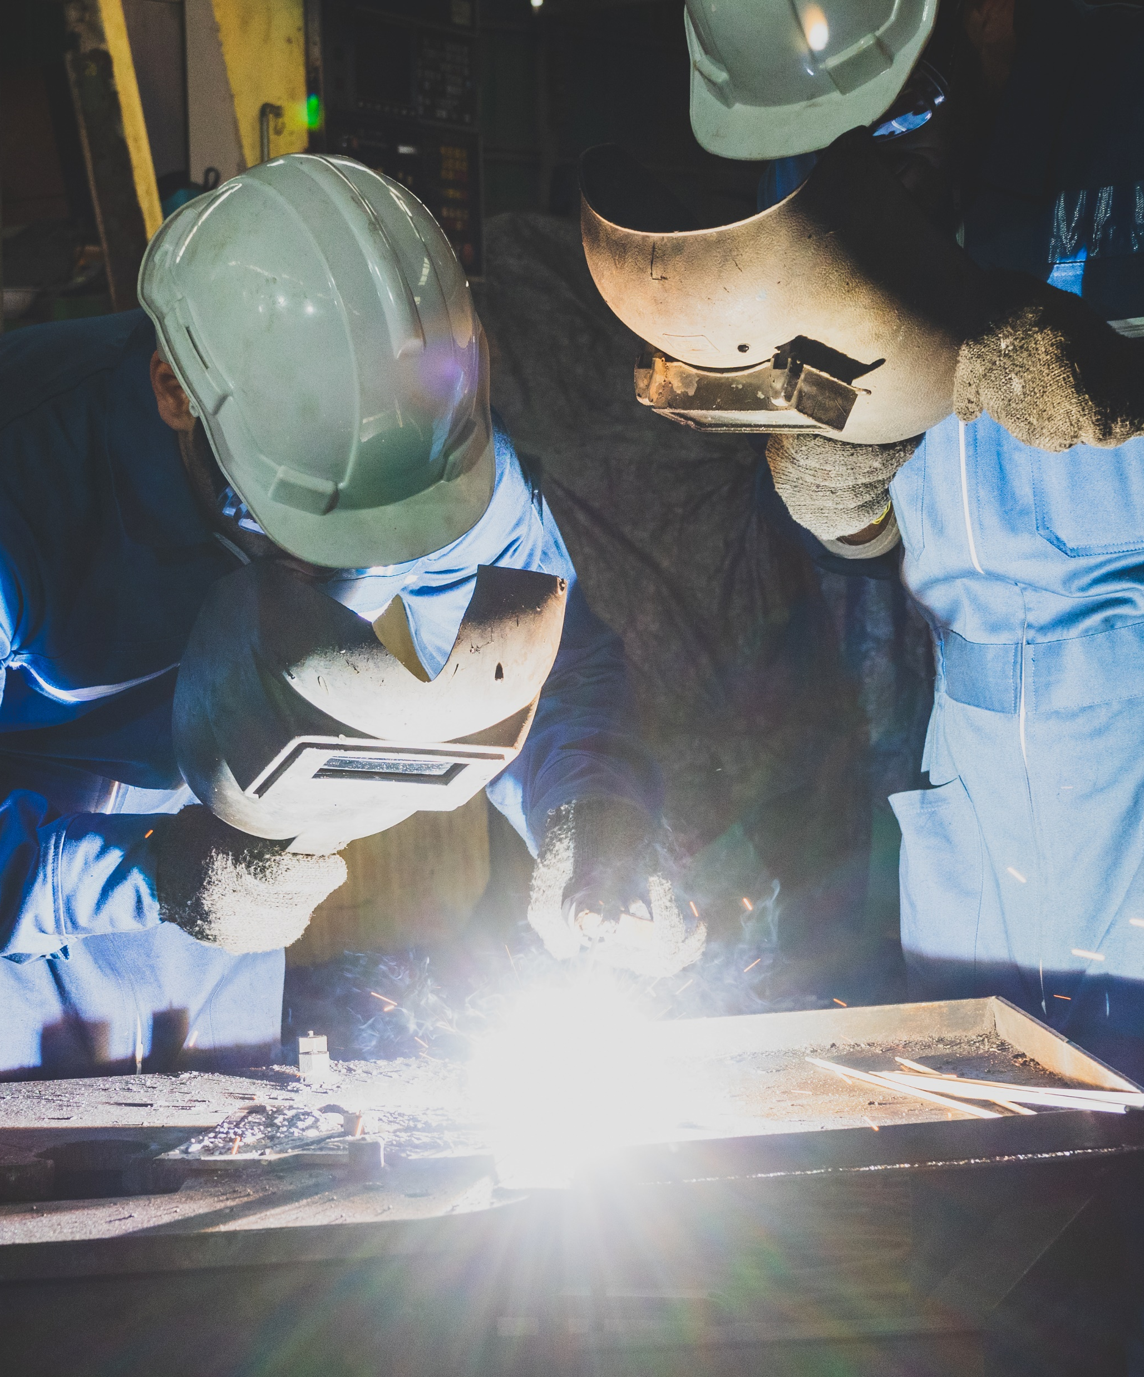

Empower the Frontlines
Performance comes from frontline – Release and enable them
3
Execution driven performance
Frontline team leaders responsible and enabled to drive performance
Supply chain 100% focused on feeding construction on time and in full
Leadership’s role is to remove the barriers
Controls provide teams with targets, structure and insights to perform and improve
Notes:
Empowerment: Ensure all critical team leads are focused on their key performance targets; and, the management team and supply chain are refocused on supporting the needs of these team leads

Slide 9
Maximise Rate at every Frontline
Continuously drive up rate through process discipline and improvement
3
Develop Efficient Processes with Clear Rates & Owners
Create a foundation for performance and improvement
Continuously Improve
Improve the most valuable processes
Maximised Rate
Secure performance quickly
Engineering - Fabrication - Construction - Commissioning
Be ready everyday
Be clear on target timings for each process step
Train and coach teams on good process
Reduce handover downtime
Improve the process
5 weeks : 50% Improvement
Build process clarity; Ensure readiness; Remove variability; Simplify the process
For all key tasks
Rail Construction – Line Laying
Steps - Owners – Dependencies - Value
Is this a common mindset? Proactively supported by all?
Notes:
Rate: Embed a far tighter focus on maximising construction rate through a constant focus on process discipline and improvement

Slide 10
Proactive Supply Chain Management
Significantly enhanced understanding & proactive management of supply chains
4
Substantially more complex & longer; More constrained than understood
Increased use of offsite & modular; Less flex in the supply chain; Non-transferable risks
Selection
More diligent
Set-up
Detailed specificity
Management
Digital transparency
Understand the full cascaded supply chain of each supplier
Understand real criticality of packages, supply chain and suppliers
Adjust plan milestones & allowances to provide enough mitigation
Contract for precise digital transparency of progress
Do not assume risk is safely transferred
Be significantly more specific about due dates (within supply chain)
Digitally track up the supply chain cascade of specific items against readiness milestones
% complete is no longer good enough
Ensure prior or supporting teams (eg: engineering) remain on track
Use AI to ”see” the issues early

Slide 11
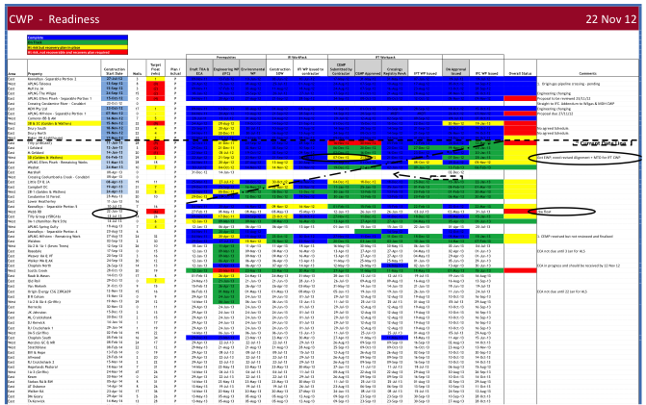
Maintain 100% Readiness across the Supply Chain
Shift the upstream focus to “Is everyone making construction ready on time?”
4
Does every supplier know specifically when they need to complete their task for each package?
Does the project know when a supplier misses a deliverable?
Act early enough to recover
Package
Due & Status
Approvals
Design
Procure
Fabricate
Ship
Site Ready
Not an even bigger P6!
Give upstream teams the precision they need to be construction led
Stop using % complete to track performance – it’s “Done or Not Done”
Real demand bumps can be smoothed out
Recovery can be completed early enough
Following teams and construction can see packages will be ready
“Engineering is usually too opaque. Readiness gives us the specificity engineering needs and the transparency the project needs. The same mindset flows down through the supply chain”
Notes:
Readiness: Hold an absolute requirement for 100% readiness on all works every shift on all teams back-up the supply chain

Slide 12
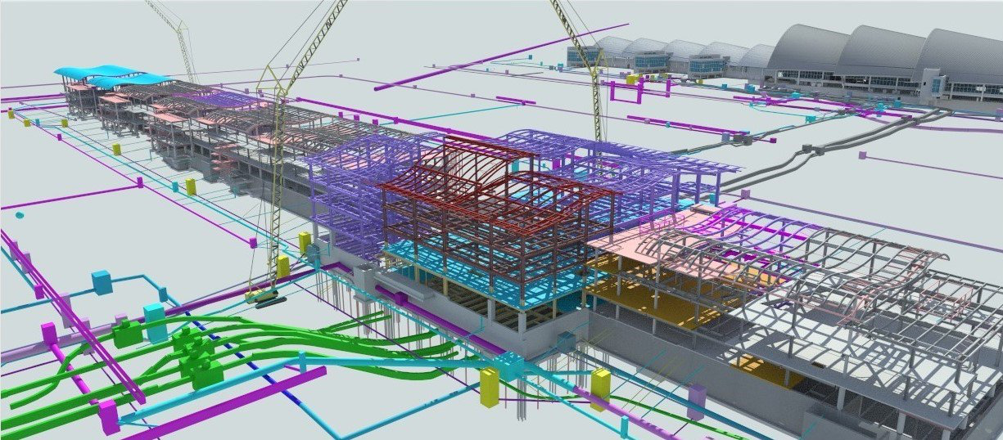
One Digital Environment Enabling All
Real time information transparency across the project and its supply chain
5
Still too many text heavy reports that report past progress and protect the contract
Digital dashboards that highlight performance & progress from one source of truth
Digital twin that enables collaborative performance & supply chain efficiency
A. Set the Foundations
Digital twin
Common data structure
Common key software
Performance reporting
>>>>>
B. Secure the Value
Performance focus
Collaboration
Productivity apps
Blockchain payments
Plan - Share - Record - Automate - Track - See - Highlight - Assure
Notes:
Transparency: Create “real-time” performance transparency across the project and its supply chain is critical to enabling the behaviours above and capturing the enhanced performance. The digital technology is now available to substantially change project performance transparency and rapidly highlight the most critical decisions so they are resolved before they become delays

Slide 13

Questions?
“It is the long history of humankind (and animal kind, too) that those who learned to collaborate and improvise most effectively have prevailed.” Charles Darwin

