Slide 1
PREVENTING BREACHES BY STAYING AHEAD OF THE GAME
Daniel Hoffiz
Senior Lead Counsel
28 November 2022

Slide 2
DISCLAIMER
By attending this presentation, you waive any and all claims against TotalEnergies, subsidiaries, affiliated companies, directors and employees arising out of your use of this TotalEnergies presentation material, information, opinions, recommendations and other data contained herein (together, the “Information”). Neither TotalEnergies nor any of its subsidiaries, affiliated companies, directors, officers, employees and controlling persons accepts any liability whatsoever for any direct or consequential loss arising from any use of the Information. TotalEnergies makes no warranty or representation as to the accuracy or completeness of the Information. The informational text, photographs, illustrations, artwork, graphics, names, logos, trademarks and service marks, are the property of TotalEnergies or licensors and are protected by copyright, trademark and other intellectual property laws. Any such content may be displayed and printed solely for your personal, non-commercial use. You agree not to reproduce, retransmit, distribute, disseminate, sell, publish, broadcast or circulate any such material to any third party without the express prior written consent of TotalEnergies.

Slide 3
BREACHES: Topics
Bankruptcy
Performance Excuses
Foreseeability
Price Adjustment
Delay
Increased Costs

Slide 4
BANKRUPTCY: Red Flags

Slide 5
BANKRUPTCY: Red Flags
“Red flags” indicating financial instability of a contractor include:
They took out a Paycheck Protection Plan loan;
One of their key employees was terminated or left;
They fail to maintain an adequate workforce; and
Deliveries of materials to a project site are delayed.
Note: Credit for some content of the Bankruptcy, Breach & Default slides belongs to Mintz, Levin, Cohn, Ferris, Glovsky, and Popeo P.C.

Slide 6
BANKRUPTCY: Pre-filing
To protect yourself in advance of a bankruptcy filing, include provisions that allow:
Termination for convenience;
A shortened cure period following notice of a default;
Immediately effective notice of default by email; &
Joint check issuance pursuant to a Joint Check Agreement.

Slide 7
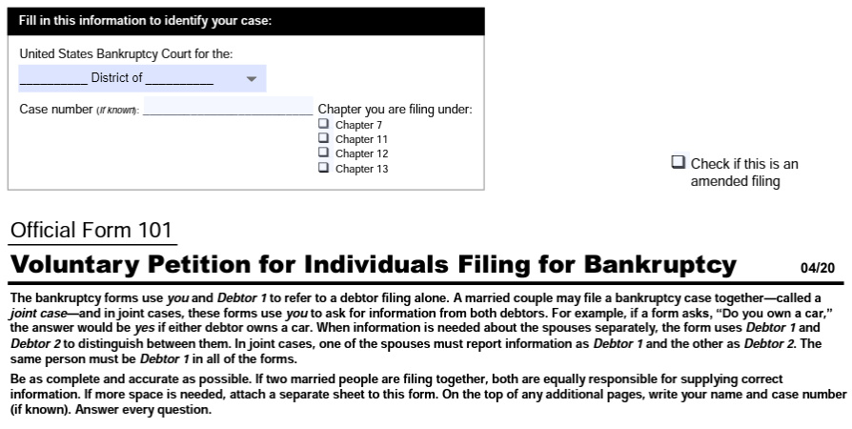
BANKRUPTCY: Protection

Slide 8
BANKRUPTCY: Automatic Stay
Debtors are protected by the “automatic stay” which prohibits most collection and enforcement actions unless authorized by the bankruptcy court, therefore:
To terminate an agreement with a debtor, a request for relief must be granted;
Your contract must have a provision that if your counterparty files for bankruptcy, then the counterparty will not oppose a request by you to waive the automatic stay; &
A waiver is not guaranteed as the requestor must demonstrate “cause” to lift the automatic stay under the Bankruptcy Code.

Slide 9
BANKRUPTCY: Assume or Reject
Even if the agreement provides that it will automatically terminate upon a bankruptcy filing, such provisions are not enforceable under the Bankruptcy Code, so include clauses that:
Require your counterparty to assume (and cure existing defaults) or reject (and allow the owner to replace the contractor); &
Include a specified period, such as 30 or 45 days after filing bankruptcy, to assume or reject.
Note: Enforceability of such provisions is not guaranteed.

Slide 10
BANKRUPTCY: Damages & Bonding
To prevent arguments and clarify rights, contracts should include:
Clearly drafted liquidated damages provisions;
The right to review a contractor’s books and records or other “audit rights” in connection with a payment application or as a remedy for an event of default; &
A covenant for contractor to remain bonded.

Slide 11
BANKRUPTCY: Pre-default Protection & Bonding
Owner’s homework:
Revisit your contractor/subcontractor due diligence process;
Require performance/payment bonds;
Review forms for inclusion of recent legal developments;
Require & obtain progress documents during construction, especially receipts for payments to subcontractors; &
Enhance & increase your inspections of the work.
See fullertonlaw.com for mechanic’s lien laws in each U.S. state.

Slide 12
PERFORMANCE EXCUSES: The U.C.C.
THE UNIFORM COMMERCIAL CODE (“U.C.C.”)
Article 2 of the U.C.C. may excuse performance where performance is rendered impracticable by either (1) the occurrence of an event “the nonoccurrence of which was a basic assumption on which the contract was made” or (2) good faith compliance with foreign or domestic government regulation.
The U.C.C. supports excuses based on pandemics and supply chain delays or unavailability.
The U.C.C. will be overridden by the terms of your contract.

Slide 13
PERFORMANCE EXCUSES: California Civil Code

Slide 14
PERFORMANCE EXCUSES: California Civil Code
Division 4. Part 4. Maxims of Jurisprudence
§3526. No man is responsible for that which no man can control.
§3531. The law never requires impossibilities.
Division 3. Part 4. Prevention of Performance or Offer
§1511. The want of performance of an obligation, or of an offer of performance, in whole or in part, or any delay therein, is excused by the following causes, to the extent to which they operate:…2. When it is prevented or delayed by an irresistible, superhuman cause, or by the act of public enemies of this state or of the United States, unless the parties have expressly agreed to the contrary;…

Slide 15
PERFORMANCE EXCUSES: Equipment Shortage
Typical performance excuses are based on force majeure, increased cost of goods or labor, unavailability of goods or labor, impossibility, impracticability, or unforeseeable delay;
To reflect supply chain realities, include an Excusable Events provision or modify your Force Majeure definition to include “shortage of equipment, inability to obtain or use necessary products or materials”; &
Always remember that the party claiming the excuse will be met by counterparty claims that the event was foreseeable.

Slide 16
PERFORMANCE EXCUSES: Commodity Price Increases
EXAMPLE: For performance excuses based on increased commodity cost, avoid breaches by including a price adjustment clause such as:
Contractor shall be entitled to a Change Order in the event that equipment required to be used or supplied by Contractor is not available due to shortage or unavailability or the price of cold rolled steel increases or decreases by 5% or more according to the U.S. Federal Reserve Bank of St. Louis steel price index at https://fred.stlouisfed.org/series/WPU101 then Seller has the right to increase or decrease the project price by X cents per percentage point as published in such index on a monthly basis in either case [during the period between the Effective Date and Substantial Completion] or [prior to Notice to Proceed].

Slide 17
PERFORMANCE EXCUSES: Price Adjustment
ICE: It is crucial that the parties agree to the specific:
Index for price adjustment;
Commodity or type of labor triggering the right; &
Event or date terminating the price adjustment right.
Note: Some parties designate the U.S. Bureau of Labor & Statistics’ Producer Price Indexes. Financiers, such as banks, like the Federal Reserve Bank of St. Louis’ steel price index.

Slide 18
PERFORMANCE EXCUSES: Price Adjustment
SHIP-M
Specify the notice & supporting documentation required;
Hurdles could be required before adjustment is permitted;
Increases & decreases in index could allow 2-way adjustment;
Profit & overhead should be addressed if not elsewhere; &
Maximum amount of price adjustment could be included.

Slide 19
PERFORMANCE EXCUSES: Foreseeability & Delay

Slide 20
PERFORMANCE EXCUSES: Delay
Delay Clause Example:
The Installation Start Date, Target Commercial Operation Date and related damages provisions and termination rights in this section will be extended by the number of days equal to the duration of delays in construction or the commencement of operation of the System due to the acts or omissions of third parties beyond the control of Contractor.

Slide 21
INCREASED COSTS: Insurance

Slide 22
INCREASED COSTS: Insurance
Increased costs impact prices for all parties.
All parties must work to manage costs, including insurance costs.
One way to manage insurance costs is for the prime contractor, not the owner, to have discretion over the policies & limits sufficient for subcontractors’ work.

Slide 23
INCREASED COSTS: Insurance
Insurance Clause Example:
All contractors and subcontractors performing any work at the Project Site in connection with this Agreement are fully licensed, insured, qualified and competent to perform the Work for which their services are retained. Prime Contractor shall determine the nature and extent of all insurance coverages necessary to afford Owner full protections arising out of any subcontracted work. In addition to maintaining its own coverages as required in this Section, Prime Contractor represents and warrants that it shall verify that each and every contractor and subcontractor maintains appropriate insurance coverages and limits and otherwise complies with the requirements of this Section.

Slide 24
INCREASED COSTS: Insurance Sufficiency
Keys to allowing the prime contractor to determine subcontractor insurance sufficiency are:
Prime contractor must be fully insured to perform the work for which their services are retained;
Subcontractor must be fully insured to perform the work for which their services are retained;
Prime contractor should be experienced enough to advise Owner that the nature and extent of all insurance coverage for subcontractors are appropriate and necessary based on the specific work subcontracted; &
Owner & prime contractor shall verify that prime contractor and each and every subcontractor maintains appropriate insurance coverage.

Slide 25
FINAL THOUGHTS & KEY TAKE-AWAYS
Before engaging a contractor, review their books and records, speak with their lead lender on the contractor’s payment history;
Make the contractor take out payment & performance bonds;
Consider a structure where you pay your contractor’s subcontractors directly;
Have a condition in your contract where you have the right to suspend payments if a contractor stops issuing contractually required reports, such as daily progress reports and payment confirmations; &
Have a contract manager actually track receipt of reports and actually suspend payments until reports are received.

Slide 26
“There are no problems, only opportunities for solutions.©” ©Daniel Hoffiz

