Slide 1
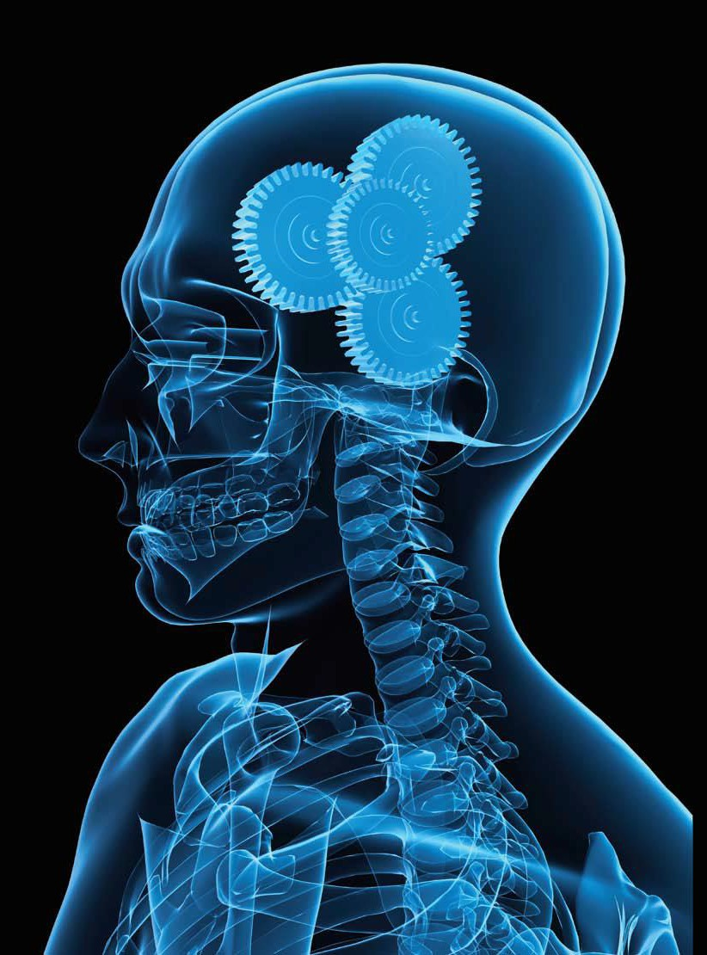
The Amsterdam EPC Project Management Forum Nov’22
The role of Human and Organisational Factors in Asset Management.
Mashel Gonyora
Manager SHE: Enablement, Compliance and Assurance Regional Operations & Asset Services
PhD Researcher Chemical and Process Engineering Candidate University of Strathclyde (UK)

Slide 2
Human and organisational factors (HOF)
HOF in Asset Management.
Influence of safety management systems on asset and safety performance
Safety critical communication in asset management
What can we learn from Asset incidents/accidents and the role of HOF?
Analysing asset data and promote continual improvement
AGENDA

Slide 3
The role of Human and Organisational Factors in Asset Management.
Human Factors in accident prevention
Human factors refer to environmental, organisational and job factors, and human and individual characteristics, which influence behaviour at work in a way which can affect health and safety” (HSE)
Human Factors covers a huge range of topics, which can be grouped under three key headings:
Assets Processes and systems People
Plant and equipment should be designed, located and modified to reduce errors during use, maintenance, inspection and testing.
The effects of the environment in which plant and equipment is operated must also be considered.
Design should consider emergency situations when errors are more likely.
Procedures should be clear and practical.
Risk assessment and incident investigations should consider human factors.
Organisations must manage change. Staffing levels and workloads must not jeopardise safety.
Human performance is about understanding how people interact with the plant, process and each other as part of a system to manage risk
People need the right training and competence along with the right level of supervision.
Strong safety leadership should underpin everything.
Human error and its management should be understood along with influencing factors like fatigue.
3

Slide 4
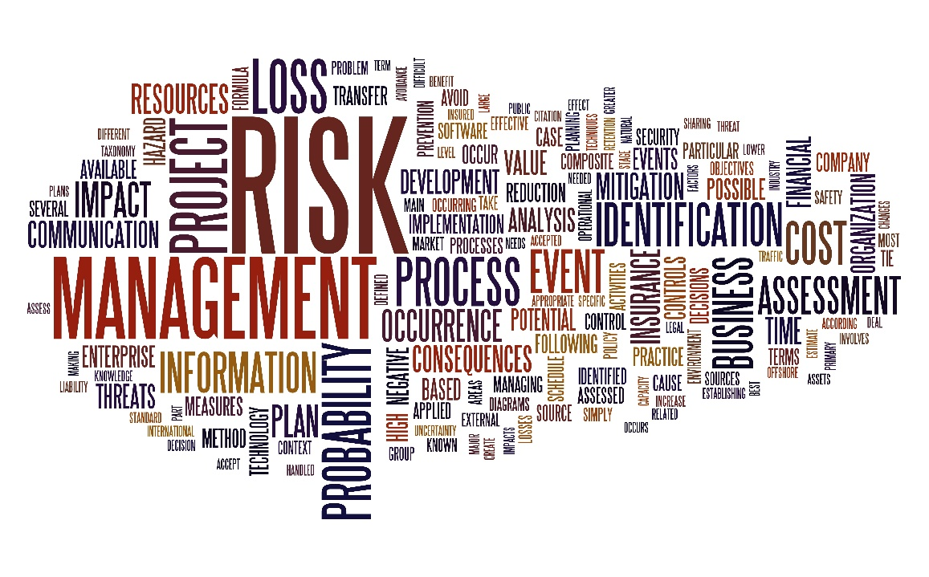
The role of Human and Organisational Factors in Asset Management.

Slide 5
Fundamentals of SHE Standards & Legislation
Establishing SMART goals and target
Ensuring the right organizational structure, responsibility, and authority
Risk management
Environmental management system
Management of engineered change and nonengineered change
Communications, stakeholder engagement, and stakeholder management
Prestart-up safety reviews Operations integrity audit
Maintenance-related major accidents, like other major accidents, can be caused by technical, human and organizational factors
•
•
•
•
Facility & Technology
•
•
Process safety information (PSI)
Process hazard analysis (PHA)
Physical asset system integrity and reliability
Operations and maintenance controls
Quality assurance (QA)
Mechanical integrity (MI)
Operating procedure and safe work practices
SHE Standards & Legislation
Process and systems
People
Management, leadership, and organizational commitment and accountability
Leadership and management review Legal requirements and compliance
Security management and emergency preparedness Qualification, orientation, and training
Contractor management
Event management and learning Management of personnel change
•
•
•
•
•
•
•
An alignment between the processes, the technology and the people within an organization is key.
4

Slide 6
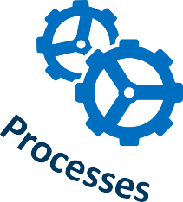
Influence of safety management systems on asset and safety performance
ASSET MANAGEMENT
COMPLIANCE
& ASSURANCE
5

Slide 7
Examples of managements systems
Safety management systems on asset and safety performance
Going beyond SHE standards and legal compliance to best practices to reduce risks;
Going beyond mere compliance with SHE standards, but learning from operating experiences, incident and near miss investigations, hazard studies, audits, and other assessments to achieve world-class performance;
Major incidents continue to strike different industry at regular intervals. A closer look and analysis of the incidents depict that the root cause of many of the incidents are alike and follow a pattern;
Identifying and implementing not only these external standards that must be observed, but also those that represent best practices that can lead to process safety excellence.
ISO 14001:2015
ISO 45001:2018
IMS
ISO 9001:2015
ISO 55001
OSHA PSM
Standard
6

Slide 8
Safety critical communication in asset management
Safety critical communications must be clear, unambiguous and understood by all involved.
Organisations with a positive safety culture have communication based on mutual trust, shared perceptions of the importance of safety, confidence in the effectiveness of preventive measures and support for the workforce.
Trust (No Blame) is a key foundation for the development of an effective safety culture (Parker et al., 2006).
Workplace trust is an important component of an effective
safety culture.
Without a certain degree of trust it is almost impossible to establish or maintain successful organizational relations over extended periods of time.
The longevity of trust relations is thus important for sustainability and continuous improvement.
7

Slide 9
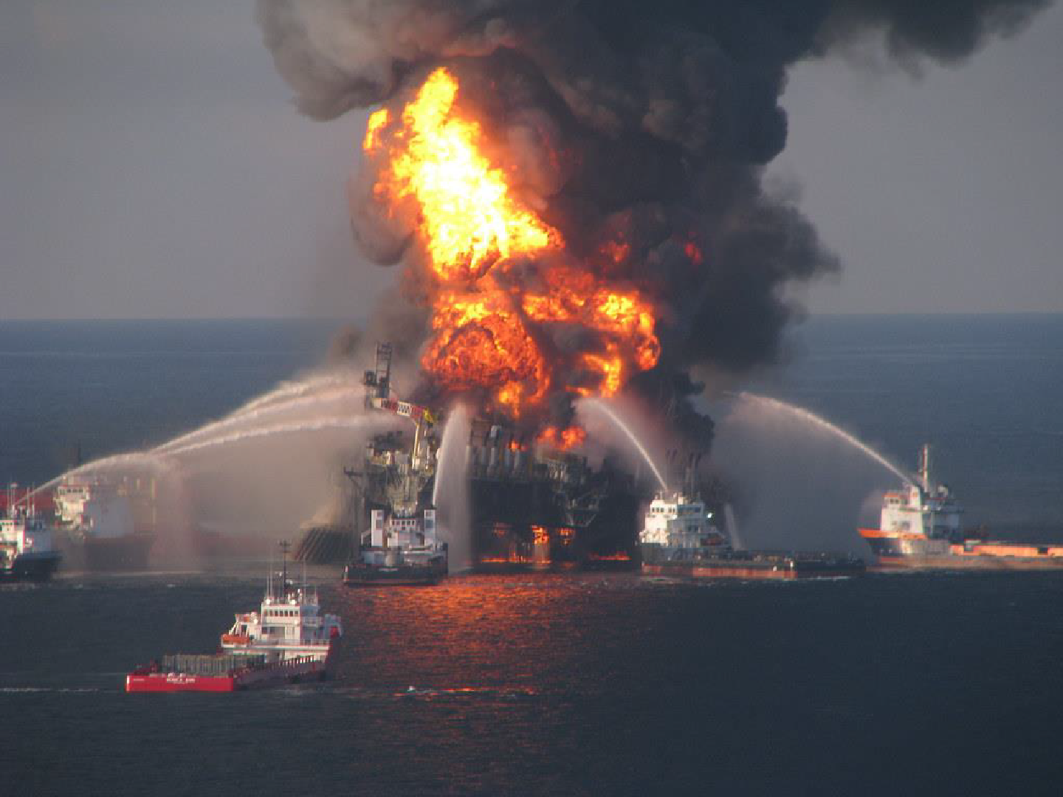
What can we learn from Asset incidents/accidents and the role of HOF?
Why accidents still happen?
Belief: It cannot happen to our plant/process.
Reports from past disasters:
Points out in some respects that there are no new accidents.
Rather there are old accidents repeated by new people.
"Coast Guard_100421-G-XXXXL- 003 - Deepwater Horizon fire" by Florida Sea Grant CC BY-NC-ND 2.0
8
The industry is regrettably not learning effectively from the lessons from previous incidents as the incidents keep on repeating themselves in different geographies but with similar root causes

Slide 10
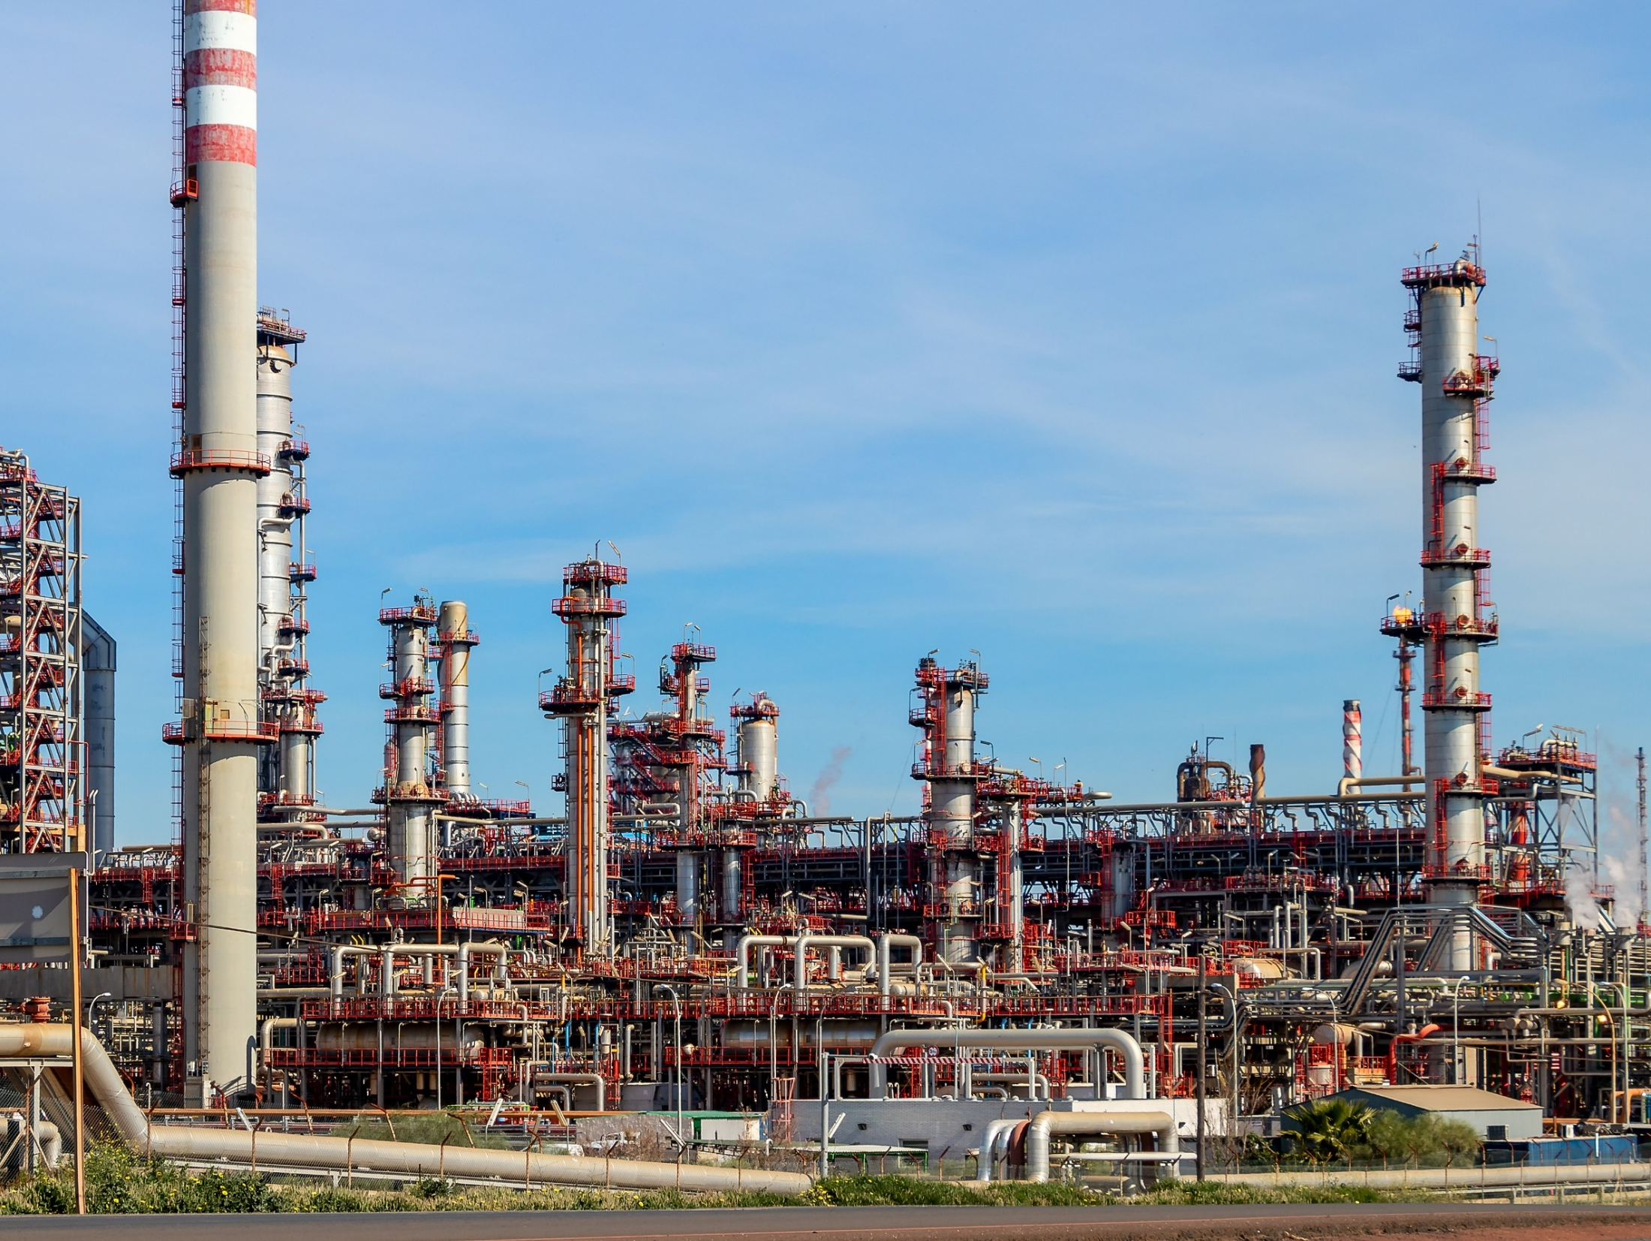
What can we learn from Asset incidents/accidents and the role of HOF?
A mindset shift in assets incidents investigations
Before, investigating incidents was an exercise of assigning blame, i.e., Asked who was involved and who was at fault
Now, we need to understand assets incidents from the point of view of what happened and why
Combine learning and proven industry practices to enable safe and reliable operational performance

Slide 11
What can we learn from Asset incidents/accidents and the role of HOF?
Identification of causes in relation to:
Organisation and workplace Factors
Maintenance Management Process
Accident Process
Work Process
Organisational accident perspective
Lack of maintainability
Deficiency in fault diagnosis
Deficiency in planning
Deficiency in scheduling
Deficiency in execution
Deficiency in checking
Lack of barrier maintenance
Barrier maintenance error
New hazard
Initiating event
Latent failures
Deficiency planning/scheduling
Deficiency STO
Deficiency Maint. Prep
Deficiency Maint. Performance
Deficiency startup
Deficiency operations
Deficiency learning
Deficiency decision making
Deficiency communication
Deficiency monitoring
Deficiency Emergency response plan
Perspectives of accident causes
10

Slide 12
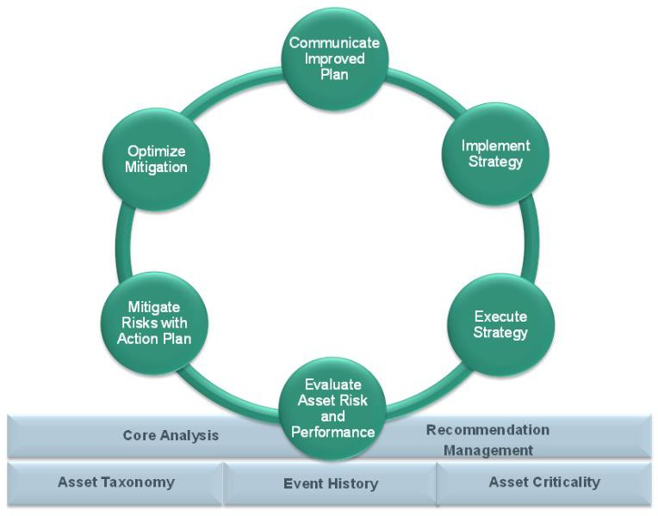
Analysing asset data and promote continuous improvement:
Risk Based Inspections(RBI)
Failure Catalogues
Root Cause Failure Analysis(RCA)
Bad Actor Improvement Plan(BAIP)
Equipment Maintenance Strategies(EMS)
Failure Mode and Effect Analysis(FMEA)
Asset Strategies Overview
11

Slide 13
12

Slide 14
tatenda
Mashel Gonyora
mashel.gonyora@strath.ac.uk mashel.gonyora@sasol.com
+27785215106
13

