Slide 1

EPC Project Management 2022

Slide 2




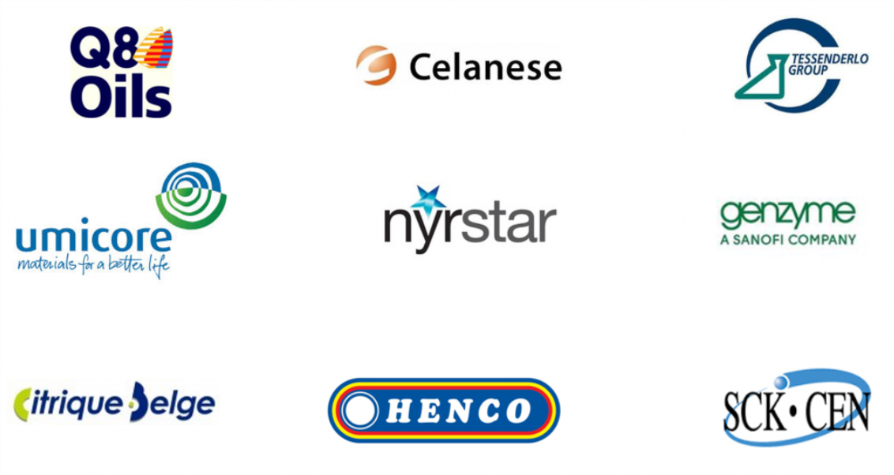
The missing link between Maintenance and Project
Rudi Frederix
GM & Co-founder
AMOTE

Slide 3

People
It’s often said ‘the right’ people are the most important asset of an organization’
But what are the right people?
In our fast changing and extremely competitive market environment you need people that go that extra mile. In other words: A happy team, these days, isn’t sufficient anymore
What were looking for is engaged people.

Slide 4
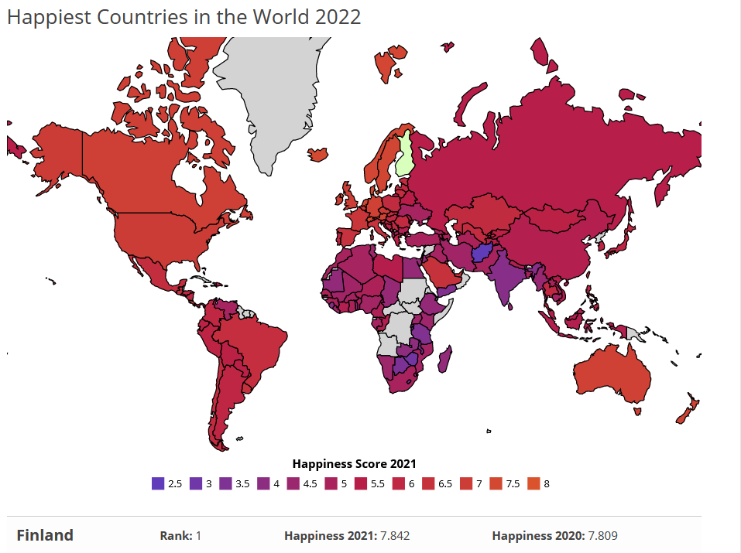
*Gallup polling data from 149 countries

Slide 5
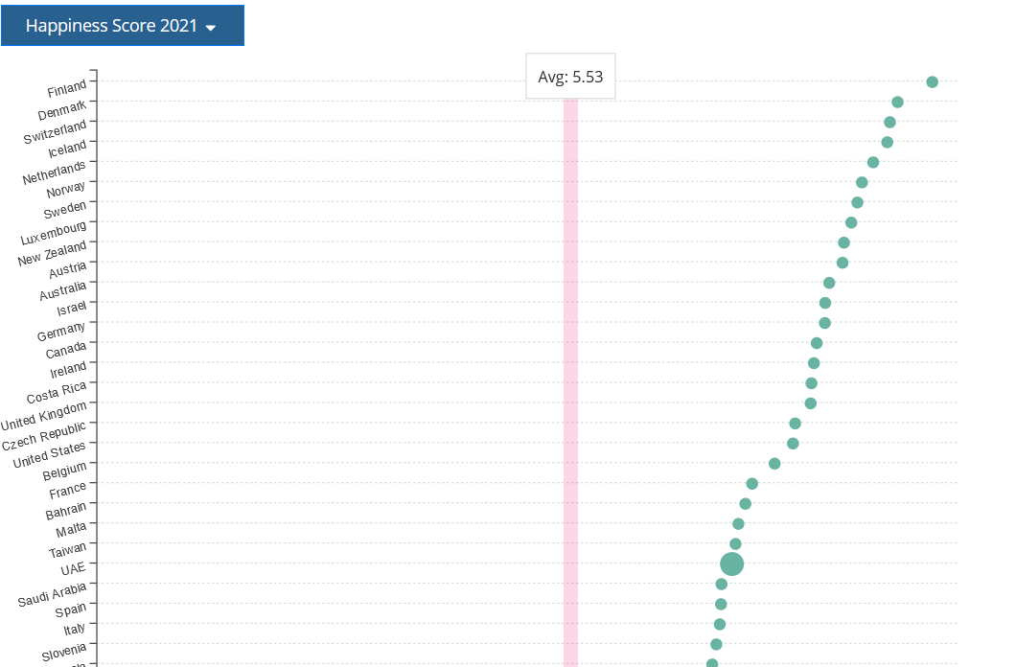
Netherlands
Happiness Score 2021:
7,41
Belgium
Happiness Score 2021:
6,8
Saudi Arabia
Happiness Score 2021:
6,52
Gallup polling data from 149 countries

Slide 6
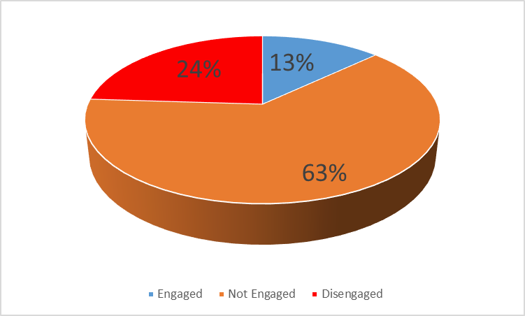
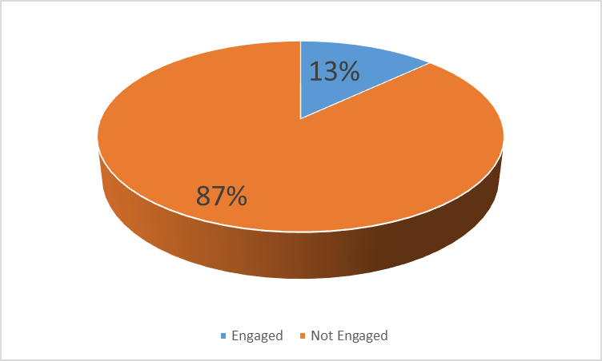
People
As more of the world moves toward knowledge-based economies, competitive advantage increasingly depends on the effectiveness with which businesses develop and deploy their human capital -- that
is, their employees' knowledge, skills and talents. However, the vast majority of organizations are not
well-calibrated to meet this all-important need, contributing to the bleak finding from Gallup's new State of the Global Workplace report that just 13% of employees worldwide are engaged in their jobs. Conversely, 87% are functioning below their potential -- in terms of both their value to employers and the sense of fulfillment they derive from their work.
knowledge, skills and talents.
just 13% of employees worldwide are engaged in their jobs.
87% are functioning below their
potential
What’s worse is that 63% of the workforce is not engaged at all.
What’s worse is that 63% of the workforce is not engaged at all. But wait, the news gets even more disheartening. An astounding 24%, one-quarter of the global workforce, is actively disengaged right now. Essentially we have a significant number of workers doing their best impression of corporate zombies who go through the everyday motions to collect a paycheck
An astounding 24%,
10%
is actively disengaged
Overall, just 10% of employed residents in Western Europe are engaged -- that is, involved in and enthusiastic about their work. Among the region's 18 countries, this figure tops out at 17% in Norway, and it is well below 10% in France, Italy and Spain .
just 14% of employed residents in Western Europe are
engaged
and it is well below 10% in France, Italy and
Spain
Gallup

Slide 7
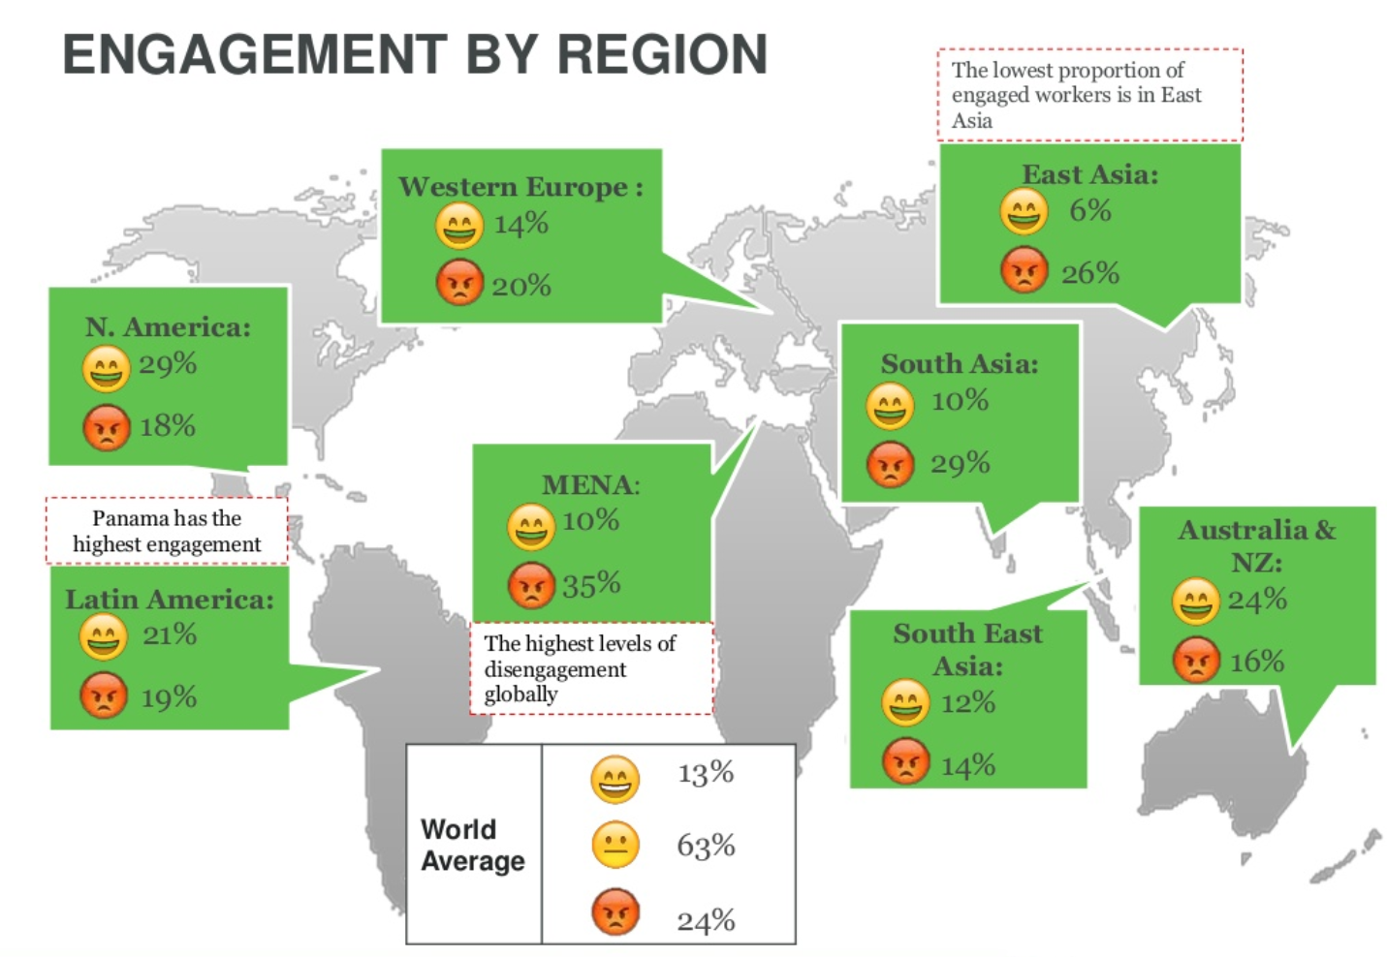
People
* Gallup

Slide 8


People
contentment vs engagement

Slide 9

People
Director
13%
Engaged
63%
Not Engaged
Management
24%
Disengaged
Engineers
Tech. & Adm.
coördinators
Technicians

Slide 10



People
Power of the market, the world …
3-D Smarts
Information
Explosion
Switch ^{3-D}
3-D Age
2-D Smarts
2-D Age
Information Shortage
Information Luxury
Source: Jef Staes (Fenestra bvba)

Slide 11





People
Knowledge ?
Notes:
Een diploma geeft alleen aan wat je geleerd hebt, maar niet wat je kunt!

Slide 12
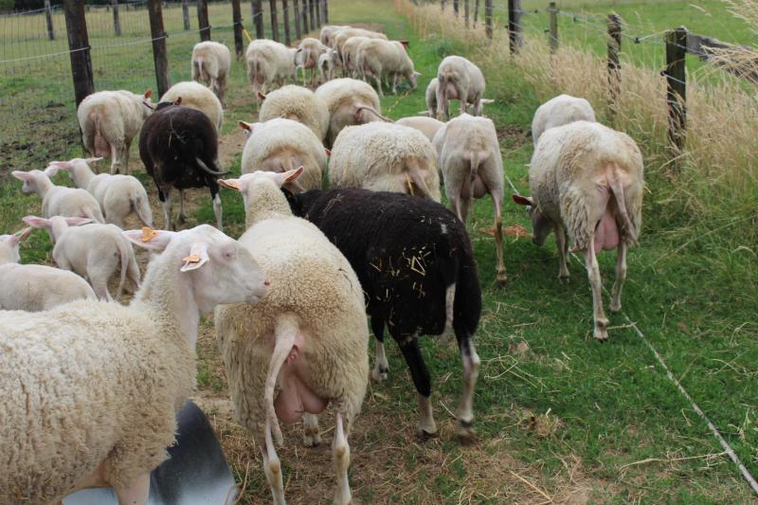

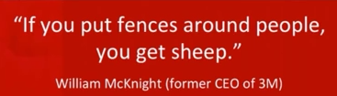

People
How it all Connects
Empowerment
Knowlegde
Success
Passion
People
Ownership
Recognition
Engagement

Slide 13
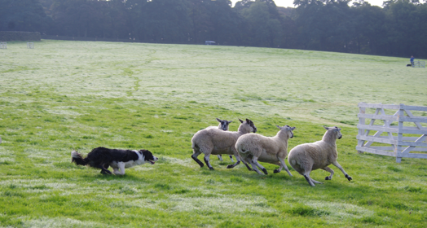
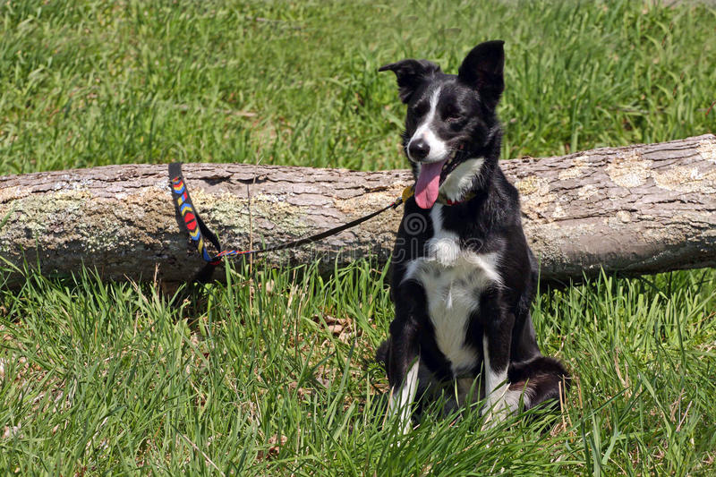
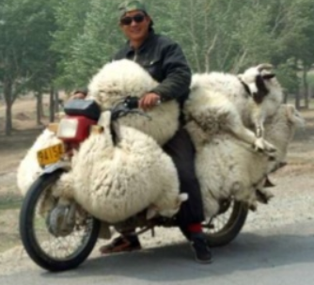
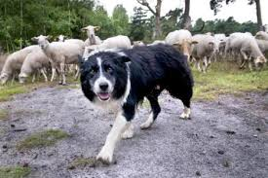

People
In control
Under control
Out of control
Sheep Management
No control

Slide 14
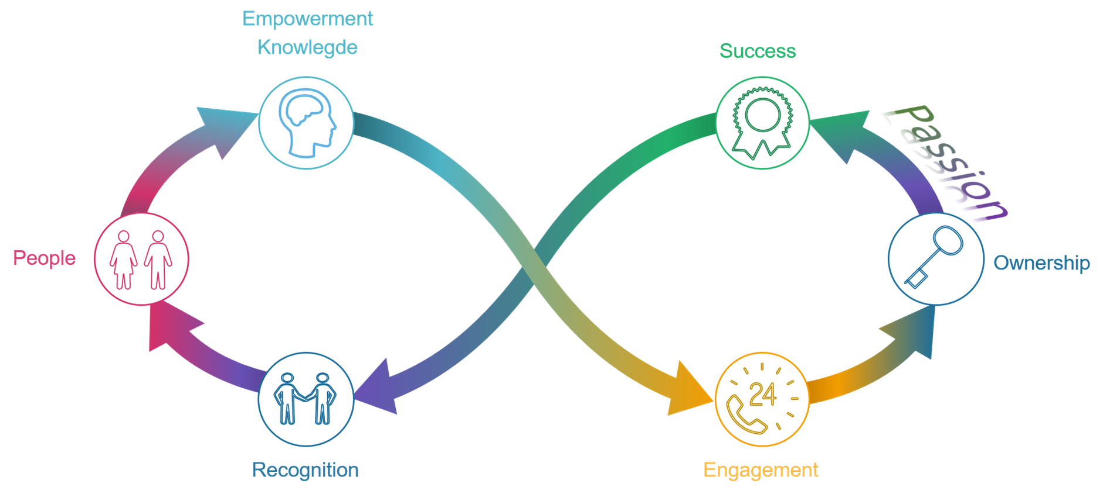
People

Slide 15

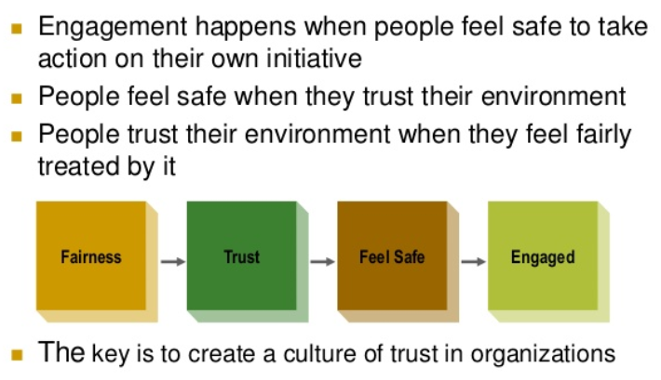

People

Slide 16


People
Change?
What’s in it for me?
Jack Welch
Change before you have to !
Jack Welch

Slide 17




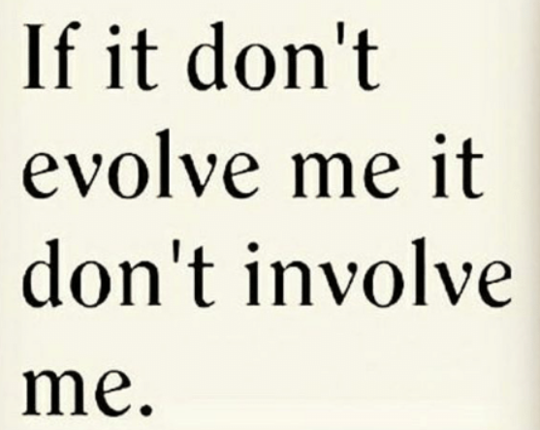

People
Notes:
1. slechts 13 % is ge-engageerd
2. Empower uw mensen en maak gebruik van hun kennis
3. If it don’t evolve me it don’t involve me.
4. Change before yoy have to.

Slide 18
Change traject case study
Food:
The reason for the optimization of the Maintenance & Engineeringsdepartment:
Cost reduction caused by the financial situation
Pharma:
The reason for the implementation of an integrated Maintenance Software:
Commercial production => License to operate
Nucleair
The reason for the implementation of an integrated Maintenance Software:
Result of the thematic inspection of FANC & Bel-V

Slide 19


Slide 20
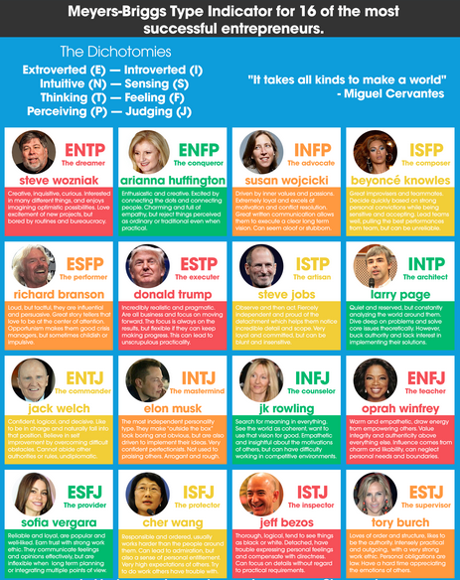
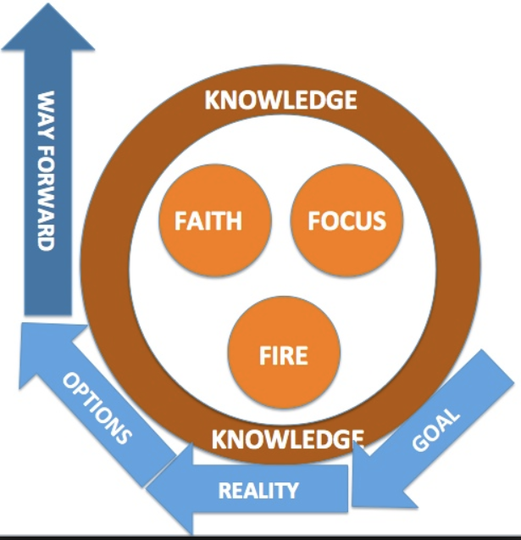
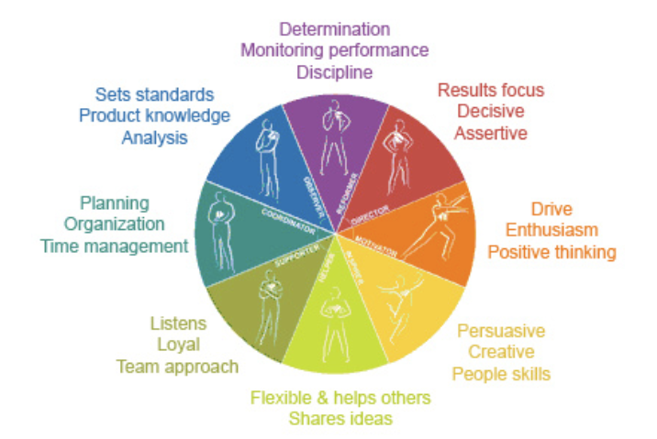


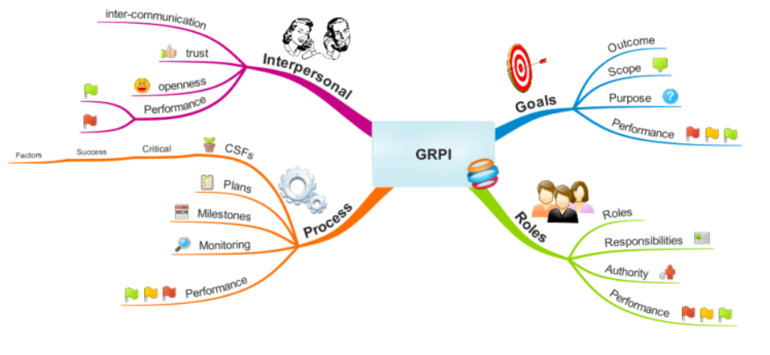
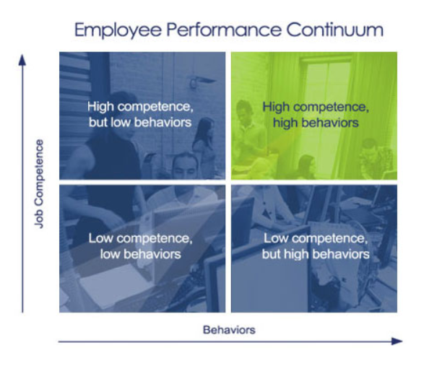
How do we start?
MBTI
Insight
GROW
GRPI
5 Strenghts
EPC

Slide 21


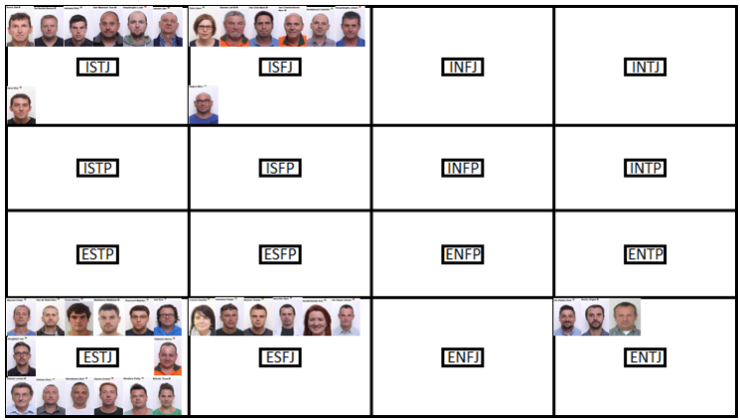
How do we start?
Notes:
Goal – Reality – Options – Way forward

Slide 22

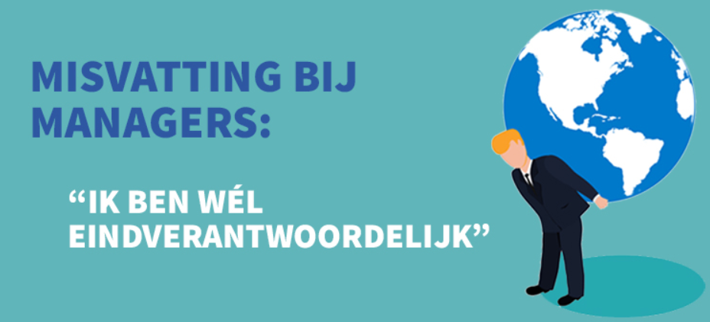
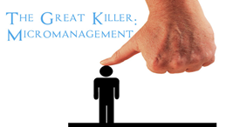


Culture Eats Strategy for Breakfast!
Misconception among Managers
At the end of the day I’m the one who’s responsible.
Rules
Directive leadership style
Director
Micro manager?
Managers
What are they doing all day?
Only Projects ?
Inferior – Less important
Engineers
>€
OK
Admin. & Tech. Coördinators
Never get the credits for things that
didn’t go Wrong
Technicians
Tja… necessary evil

Slide 23
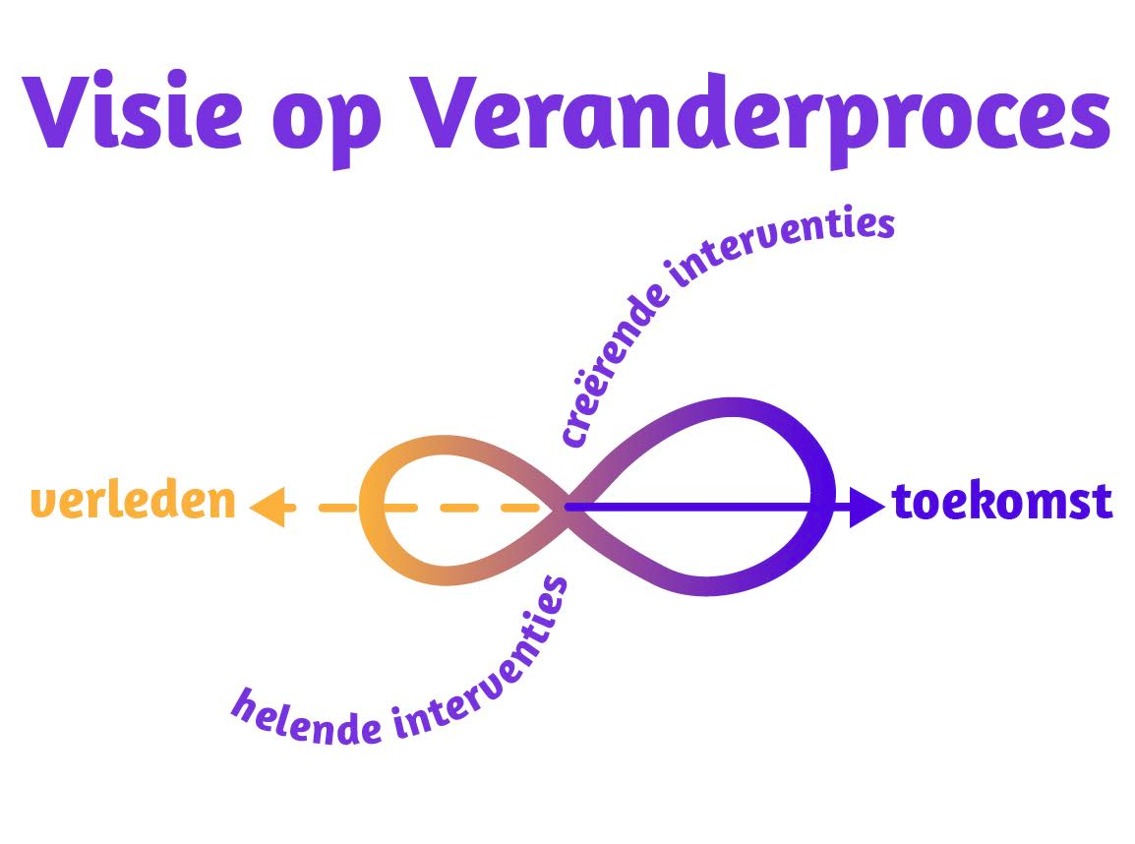

Culture Eats Strategy for Breakfast!
Vision on a change process
Creating interventions
Past
Future
Healing interventions

Slide 24

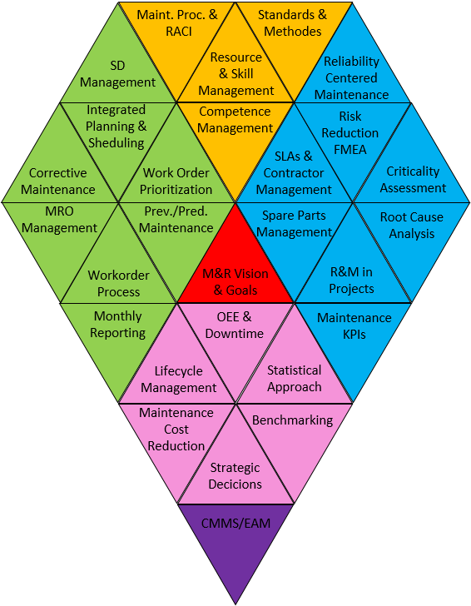
An analysis is performed (survey) regarding the performance of the maintenance
and the engineering processes with the goal to setup a Roadmap to achieve
Asset Management Excellence.
The survey to define the baseline is an asset management model based on ISO 55000

Slide 25
Resource Management &
Training
Resource &
Skill
Mangement
Maintenance
Processes &
RACI
Competence
Management
Standards
&
Methodes
Continuous
Improvement
Life cycle
Management
Maintenance
Cost
Reduction
OEE
Strategic
Decisions
Bench
Marking
Statical
Approach
Operational
Maintenance
SD
Management
Integrated
Planning &
Shedulling
Corrective
Maintenance
MRO
Management
Workorder
Prioritization
Prev./Pred.
Maintenance
Workorder
Process
Monthly
Reporting
Reliability
Engineering
R&M in
Projecten
Spareparts
Management
Root
Cause Analysis
Reliability
Centerd
Maintenance
Maintenance
KPI’s
Criticality
Assessment
FME©A
Risk Reduction
SLA’s &
Contractor Mgt.
Foundation
CMMS
M&R vision &
Goals
BAM-Model (Brilliant Asset Management)

Slide 26
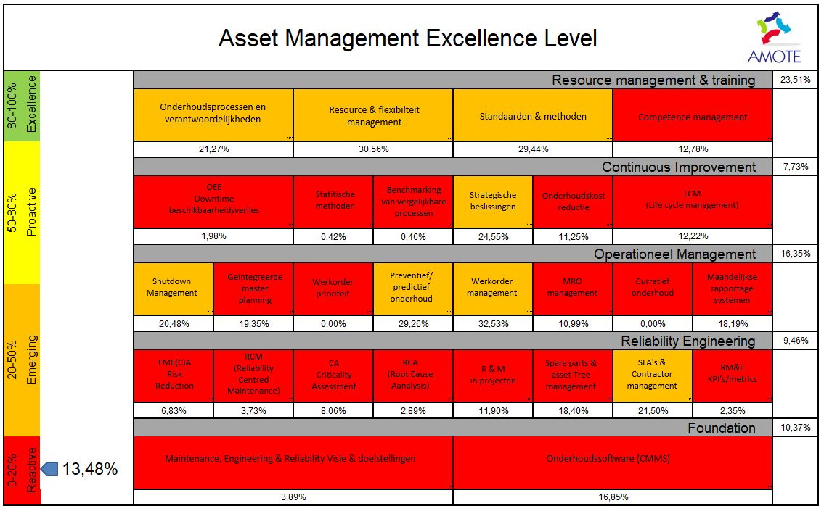
Asset Management Excellence level

Slide 27
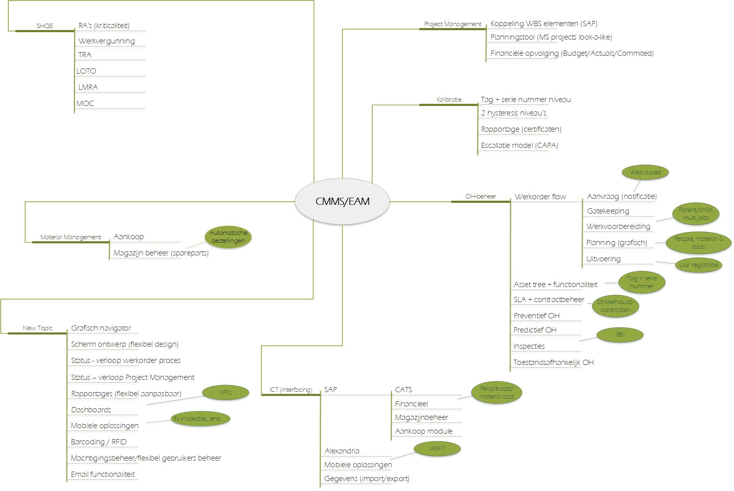
Maintenance

Slide 28
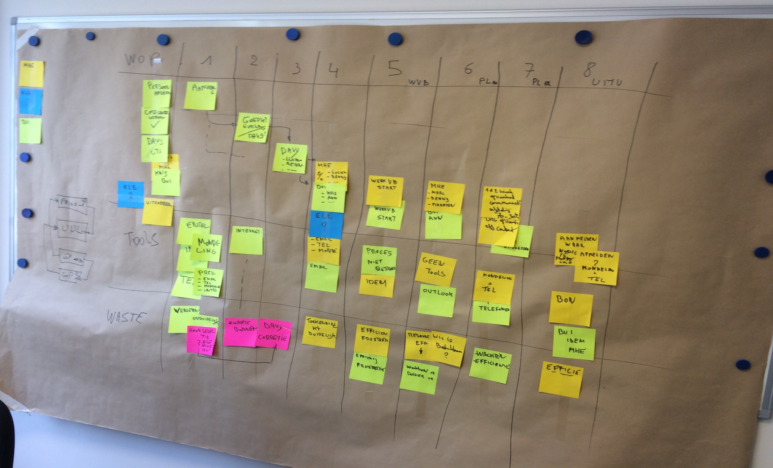
Makigami

Slide 29
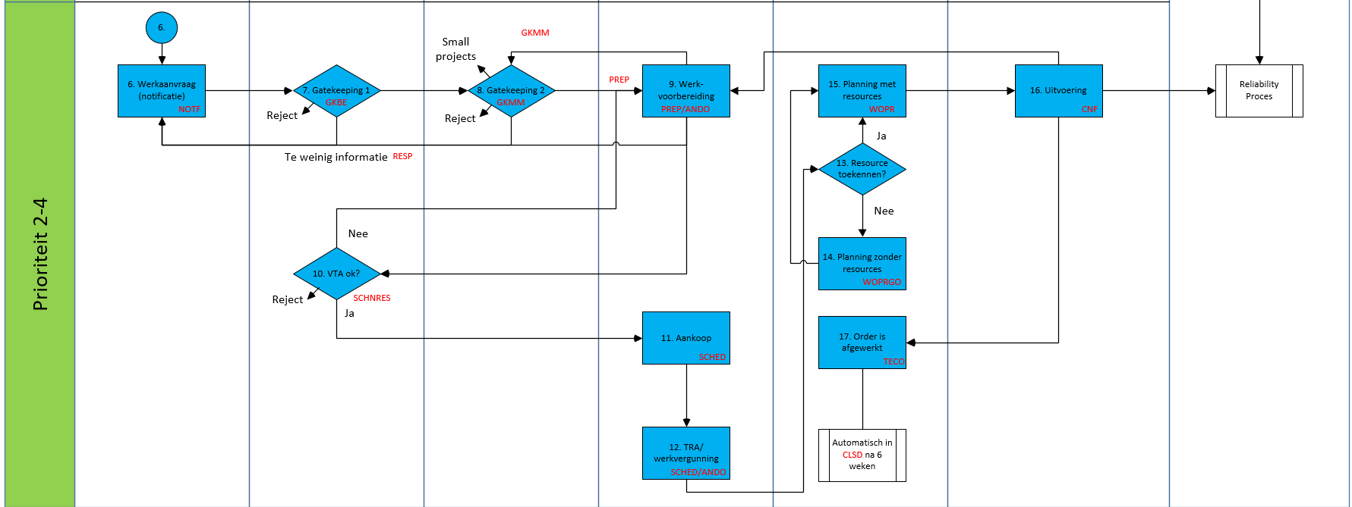
Maintenance

Slide 30
Asset Management Excellence level

Slide 31
Asset Management Excellence Program
Roadmap
Follow-up & modify the scheduling process internal & external craftsmen.
Kick-off Planning Process.
PO BUI ready
Evaluation KPI Dashboard
Start new maintenance organisation
Kick-off scheduling process internal & external craftsmen.
PO MHE & ELE ready
KPI dashboard ready
Start procedure recruitement Maintenance Manager
Modification org chart
Follow-up & modify the planning process
Evaluation PO concepts
Support the new Maintenance Manager
Prepare Implementation Asset Maintenance Triangle.
PO concepts MHE (ventilation and cooling, eso.)
Implement Workpermit & give training
KPI dashboard design ready
Procedure Planning process
Procedure Sheduling process
Procedure Maintenance & Reliability process
Hand-over Maintenance Manager
Q2 2020
Q1 2020
Q3 2020
Q4 2019
Roadmap 2020
Q4 2020
Service

Slide 32
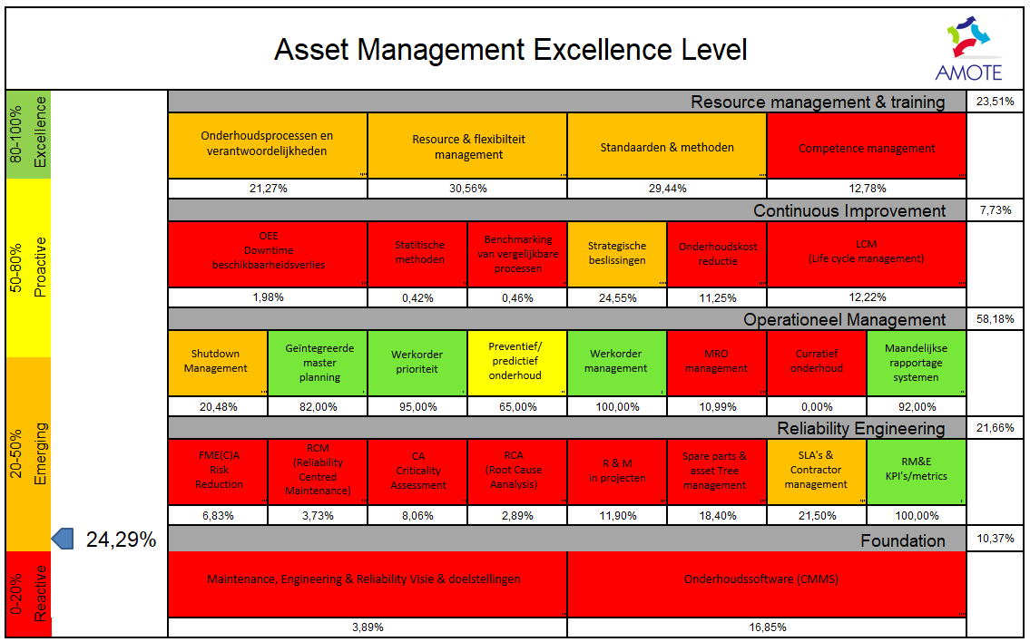
Maintenance

Slide 33
Results
1. Optimalisation of the Maintenance Process (Pharma)
- 450k€/year (planning & sheduling = WO duration reduction)
4,6h => 3,6h …. 9000 WO/Y = 9000 x 50€ = 450k€
2. Reliability (Food)
- >150k€/year (airpressure leakrepair, vacuum pumps, …)
3. SLA’s implemented (Nucleair)
- 390k€/year (7 SLA’s)

Slide 34
Change traject
Engineering
Implementation Project Management process
SCOPE
Cost
Timing
Budget (cost) & timing under control
Implementation of a
EAM software
(CMMS, CCMS, PM,…)
Planning & Sheduling under control
Increase
Efficiency
Sheduling
Planning
Maintenance
Implementation Workorder process
Process modification (Organization, processes, eso)

Slide 35
The missing link between Projects & Maintenance

Slide 36
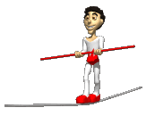
Project Management (Engineering)
Maintenance
100% Availability
Scope
Within Budget
Cost (LCC)
On Time
Reliability

Slide 37
Project Management (Engineering)
Maintenance
Appointment Reliability engineer
RA’s (Hazop, FMECA)
List of standard material
PPM plans
Spare parts management
Technical documentation
Training for maintenance
10 worst cases
RCA’s (5 W, Ishikawa, enz.)
Owner of the List of standard material
Review & Update PPM plans
Review & Update of technical documentation
Reliability in Projects
Reliability in Maintenance

Slide 38

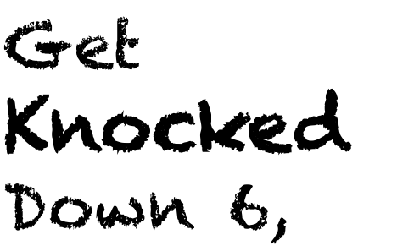

38

Slide 39

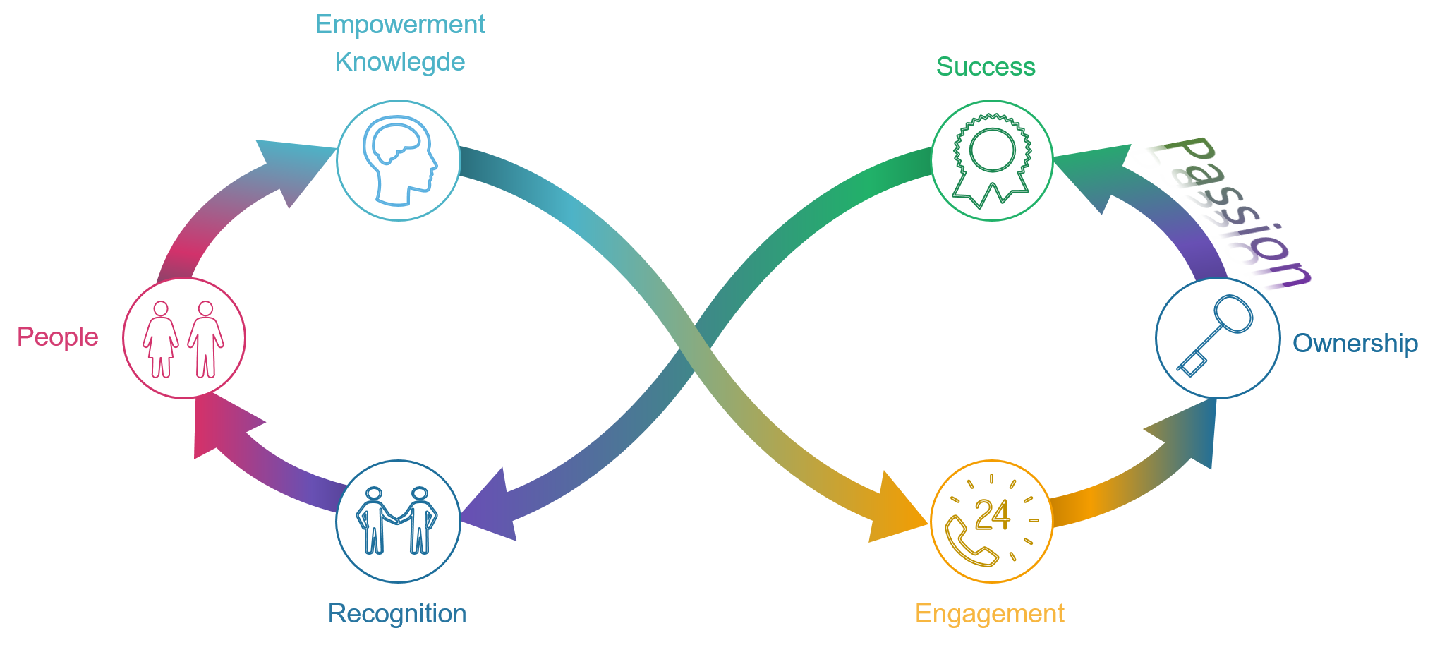

Slide 40


